Slide 1
MPOPF Simulation and OpenDSS Validation
Aryan Ritwajeet Jha
Graduate Research Assistant
Washington State University
Notes:
Remember to hit the reset button to make sure all the page elements react properly.
There are 20 different layouts that you can choose from.

Slide 2
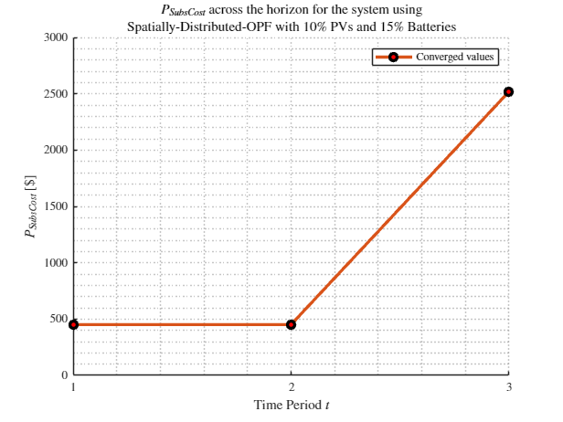
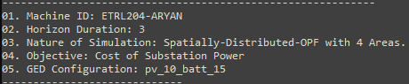
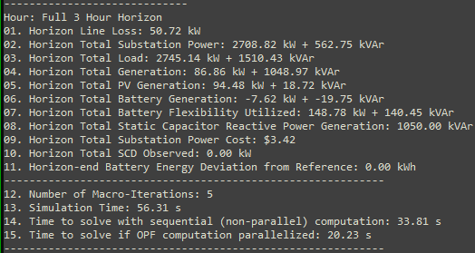
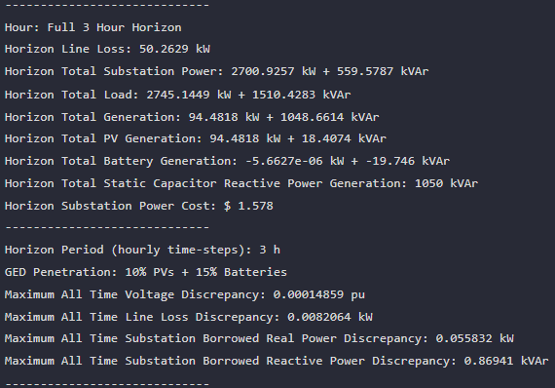

MPDOPF Verified for $T=3, PV=10\%, Batt=15\%$
strLoadShapeCost = 'New Loadshape.LoadShapeCost npts =3 interval = 1 mult = [0.048204 0.048204 0.30181]'
OpenDSS Def Profiles
Gen Cost
MPDOPF Simulation Results
OpenDSS Powerflow Results
Timings
Discrepancies

Slide 3
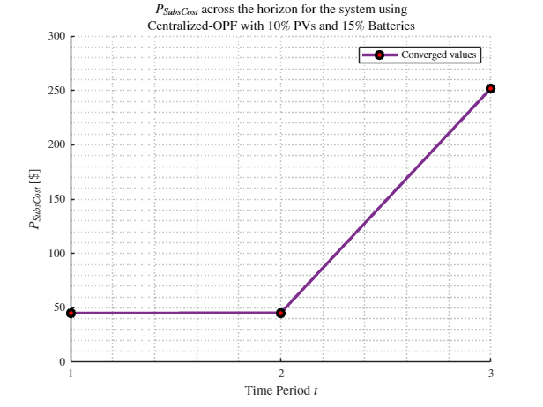
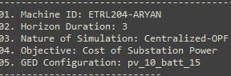
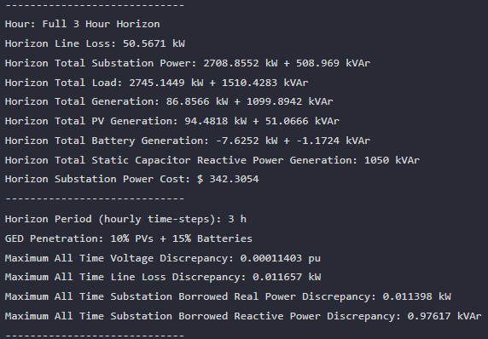
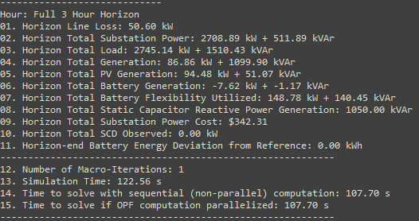

MPCOPF Verified for $T=3, PV=10\%, Batt=15\%$
strLoadShapeCost = 'New Loadshape.LoadShapeCost npts =3 interval = 1 mult = [0.048204 0.048204 0.30181]'
OpenDSS Def Profiles
Gen Cost
MPDOPF Simulation Results
OpenDSS Powerflow Results
Timings
Discrepancies

Slide 4
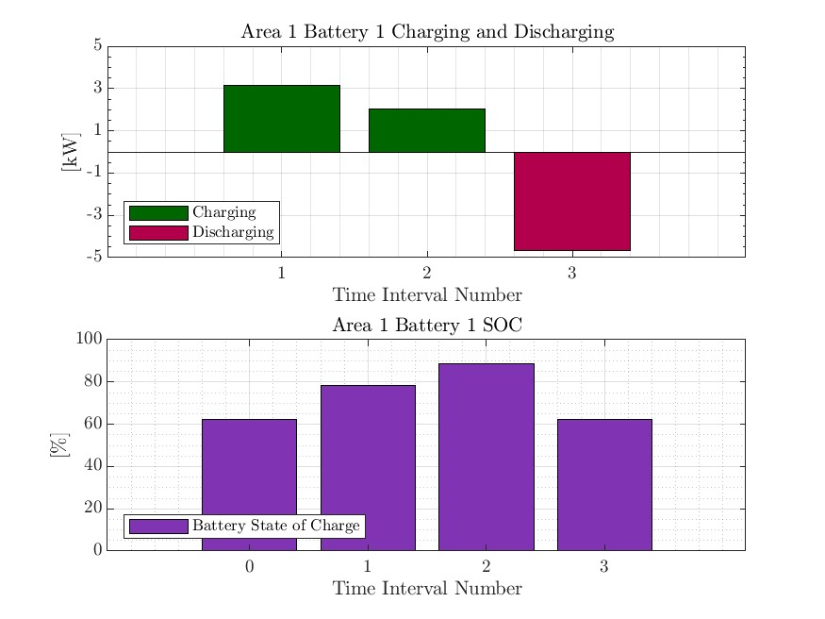
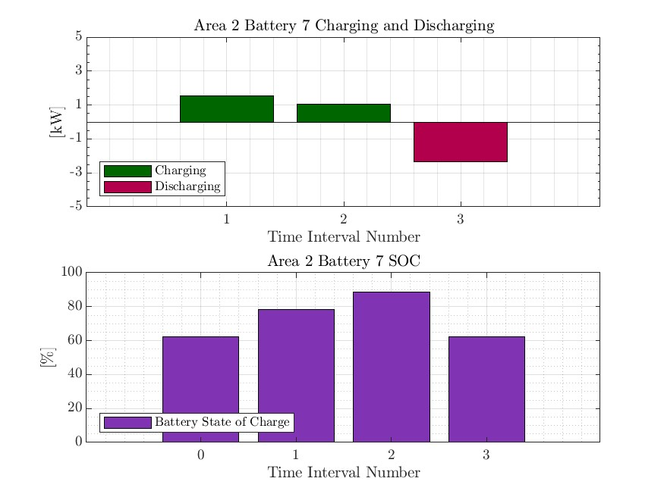
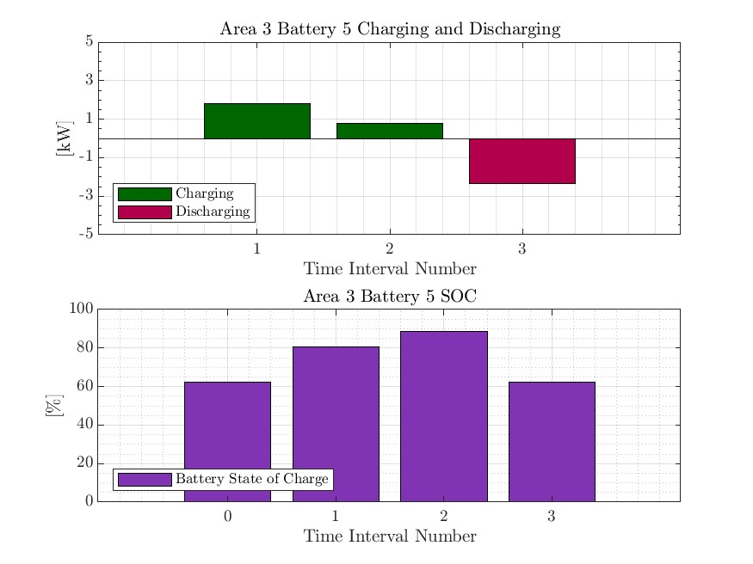
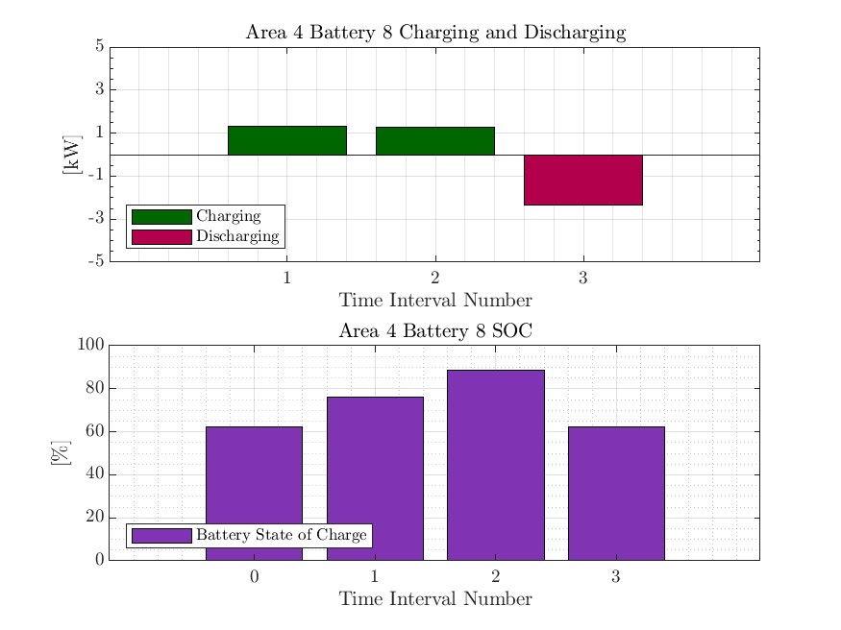

MPDOPF Verified for $T=3, PV=10\%, Batt=15\%$
strLoadShapeCost = 'New Loadshape.LoadShapeCost npts =3 interval = 1 mult = [0.048204 0.048204 0.30181]'
OpenDSS Def Profiles
Gen Cost

Slide 5
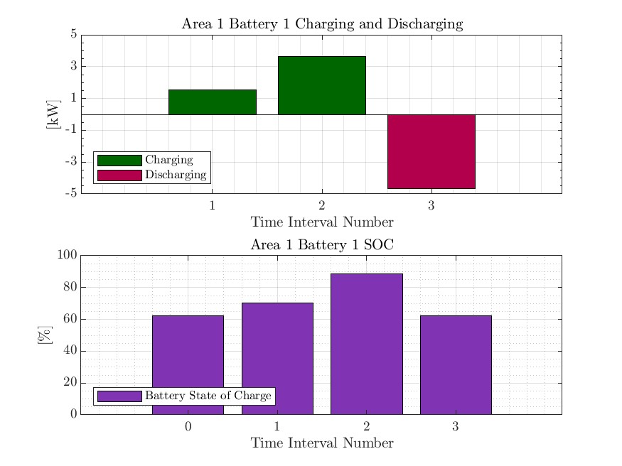

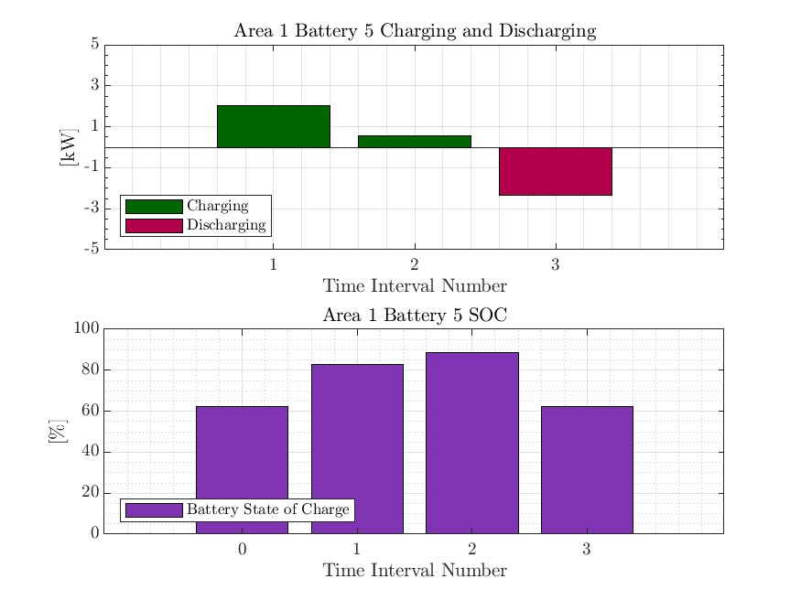


MPCOPF Verified for $T=3, PV=10\%, Batt=15\%$
strLoadShapeCost = 'New Loadshape.LoadShapeCost npts =3 interval = 1 mult = [0.048204 0.048204 0.30181]'
OpenDSS Def Profiles
Gen Cost

Slide 6
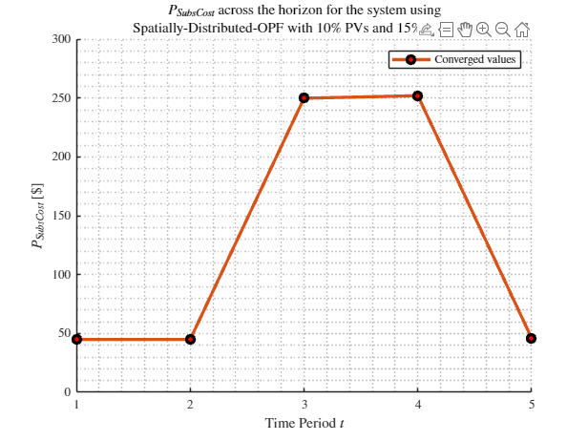
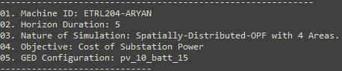
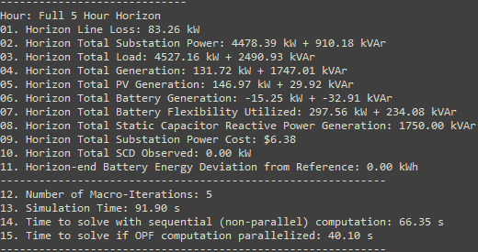
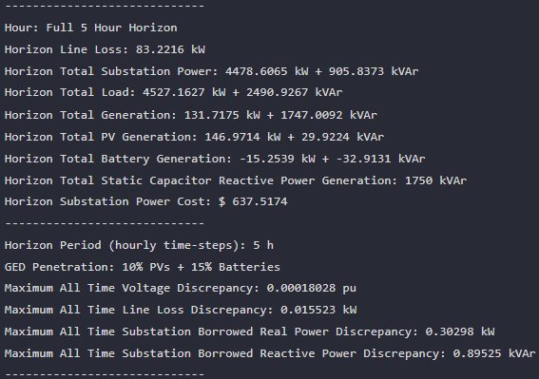

MPDOPF Verified for $T=5, PV=10\%, Batt=15\%$
strLoadShapeCost = 'New Loadshape.LoadShapeCost npts =5 interval = 1 mult = [0.048204 0.048204 0.30181 0.30181 0.048204]'
OpenDSS Def Profiles
Gen Cost
MPDOPF Simulation Results
OpenDSS Powerflow Results
Timings
Discrepancies

Slide 7
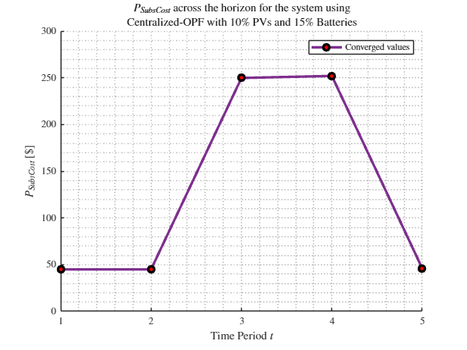
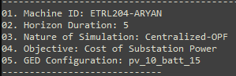
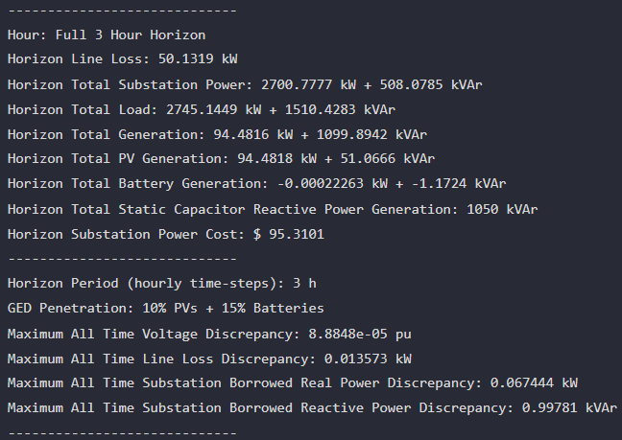
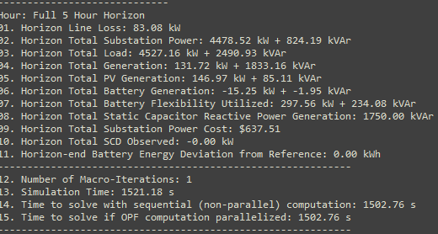

MPCOPF Verified for $T=5, PV=10\%, Batt=15\%$
strLoadShapeCost = 'New Loadshape.LoadShapeCost npts =5 interval = 1 mult = [0.048204 0.048204 0.30181 0.30181 0.048204]'
OpenDSS Def Profiles
Gen Cost
MPDOPF Simulation Results
OpenDSS Powerflow Results
Timings
Discrepancies

Slide 8

MPDOPF Verified for $T=5, PV=10\%, Batt=15\%$
strLoadShapeCost = 'New Loadshape.LoadShapeCost npts =5 interval = 1 mult = [0.048204 0.048204 0.30181 0.30181 0.048204]'
OpenDSS Def Profiles
Gen Cost

Slide 9
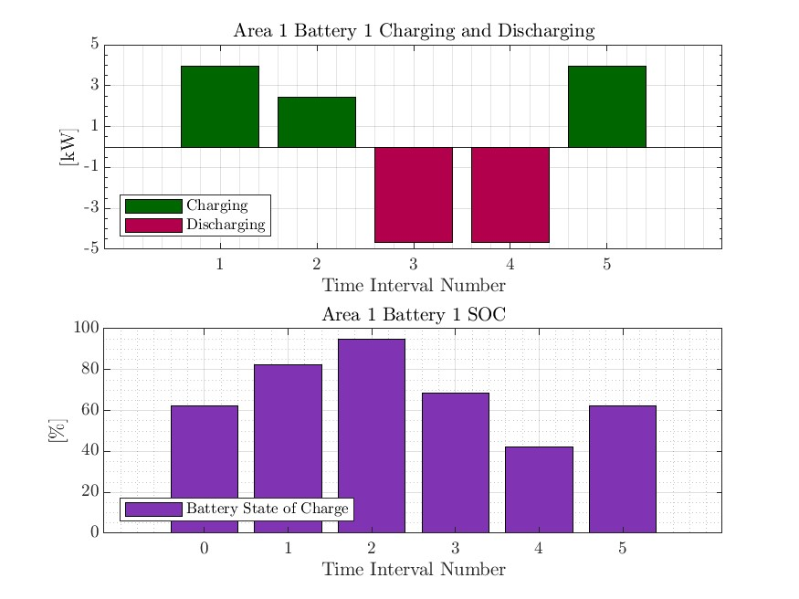
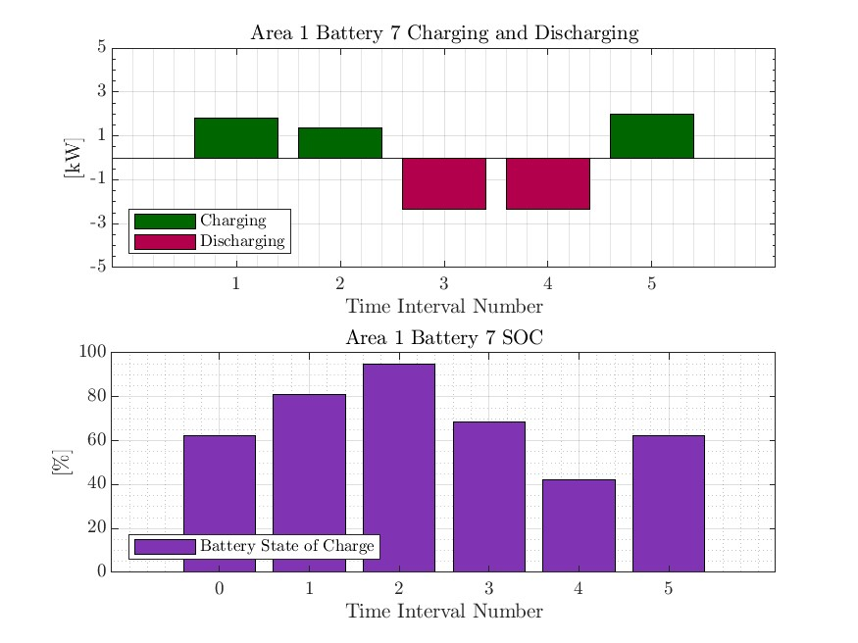
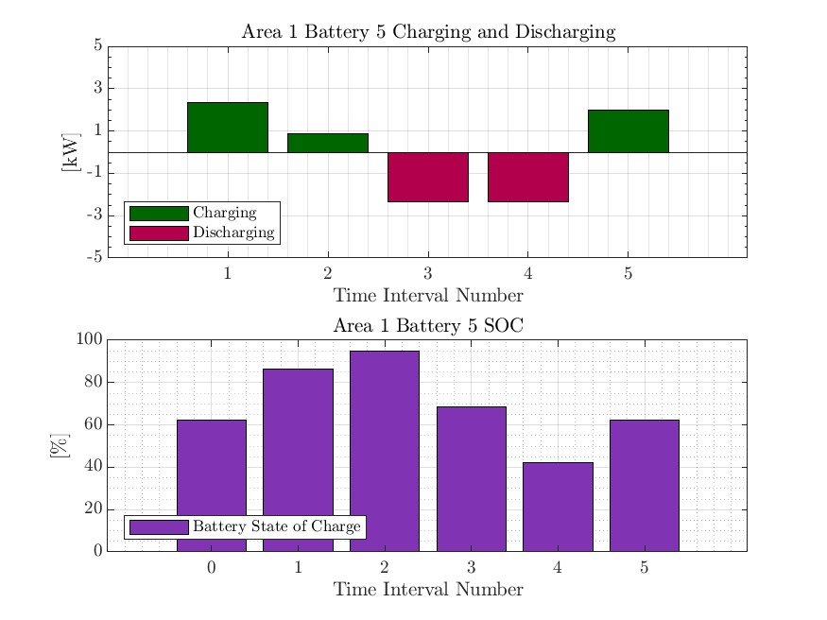


MPCOPF Verified for $T=5, PV=10\%, Batt=15\%$
strLoadShapeCost = 'New Loadshape.LoadShapeCost npts =5 interval = 1 mult = [0.048204 0.048204 0.30181 0.30181 0.048204]'
OpenDSS Def Profiles
Gen Cost

Slide 10
MPDOPF Verified for $T=3, PV=10\%, Batt=15\%$
strLoadShape = 'New Loadshape.LoadShape npts =3 interval = 1 mult = [0.777 0.787 0.796]'
strLoadShapePV = 'New Loadshape.LoadShapePV npts =3 interval = 1 mult = [0.8 0.9 1]'
OpenDSS Def Profiles
Gen Cost
MPDOPF Simulation Results
OpenDSS Powerflow Results

Slide 11
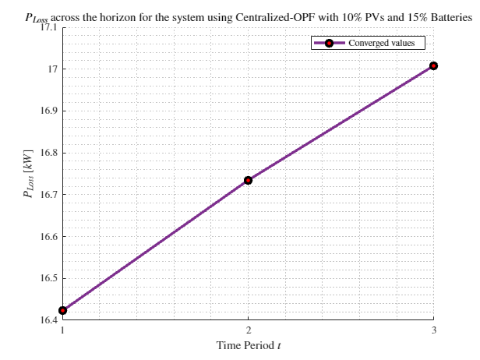
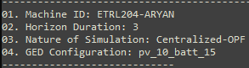
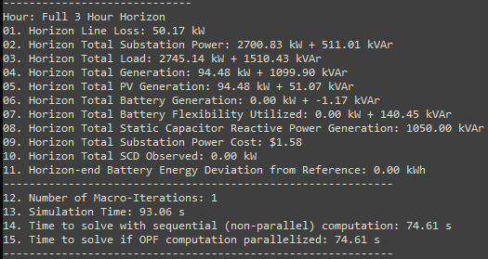
MPCOPF Verified for $T=3, PV=10\%, Batt=15\%$
OpenDSS Def Profiles
Gen Cost
MPDOPF Simulation Results
OpenDSS Powerflow Results

Slide 12
MPDOPF Verified for $T=3, PV=10\%, Batt=15\%$
OpenDSS Def Profiles
Gen Cost

Slide 13
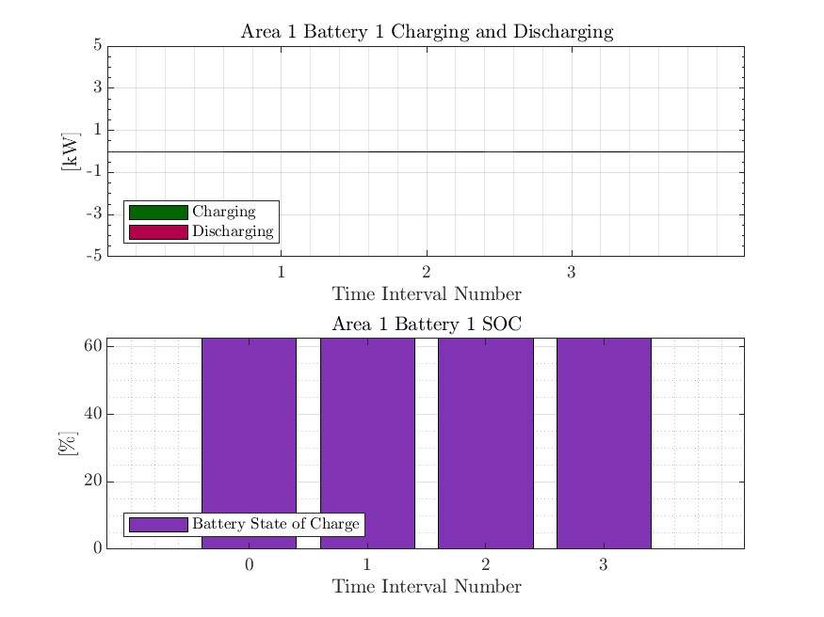



MPCOPF Verified for $T=3, PV=10\%, Batt=15\%$
OpenDSS Def Profiles
Gen Cost

Slide 14
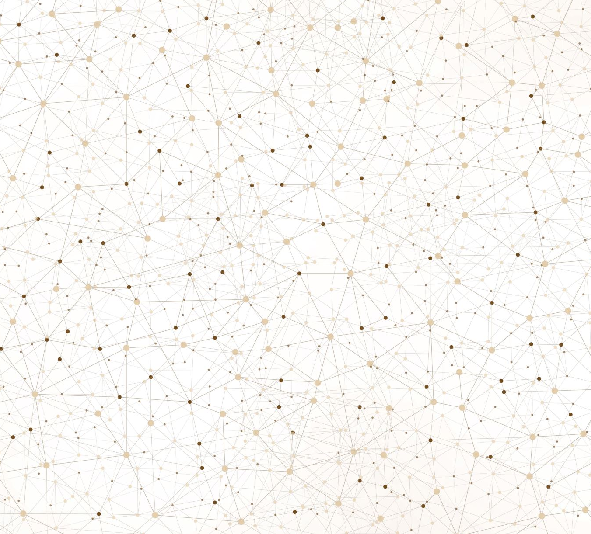
Latest Slides End Here.
Previous Slides Follow

Slide 15
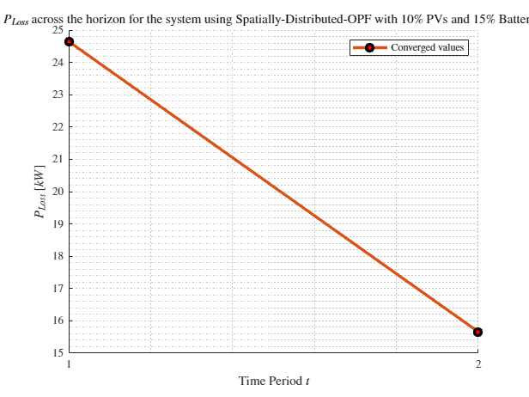
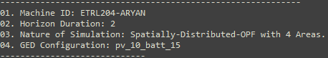
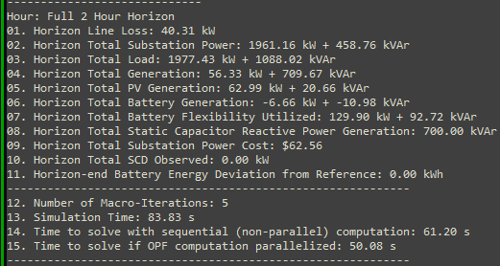
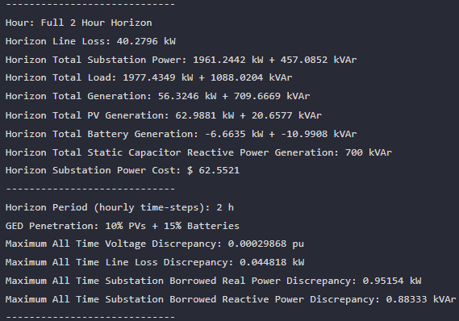

MPDOPF Verified for $T=2, PV=10\%, Batt=15\%$
strLoadShape = 'New Loadshape.LoadShape npts =2 interval = 1 mult = [1 0.7]'
strLoadShapePV = 'New Loadshape.LoadShapePV npts =2 interval = 1 mult = [1.4 0.8]'
MPDOPF Simulation Results
Alternative Profiles
OpenDSS Powerflow Results

Slide 16
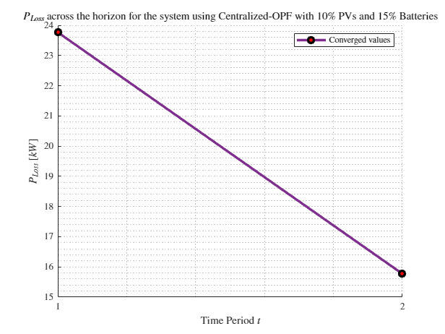
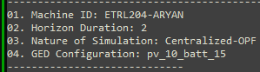
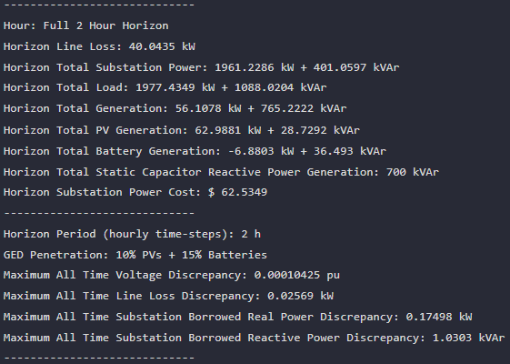
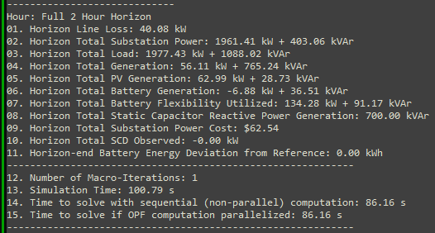

MPCOPF Verified for $T=2, PV=10\%, Batt=15\%$
strLoadShape = 'New Loadshape.LoadShape npts =2 interval = 1 mult = [1 0.7]'
strLoadShapePV = 'New Loadshape.LoadShapePV npts =2 interval = 1 mult = [1.4 0.8]'
MPCOPF Simulation Results
Alternative Profiles
OpenDSS Powerflow Results

Slide 17
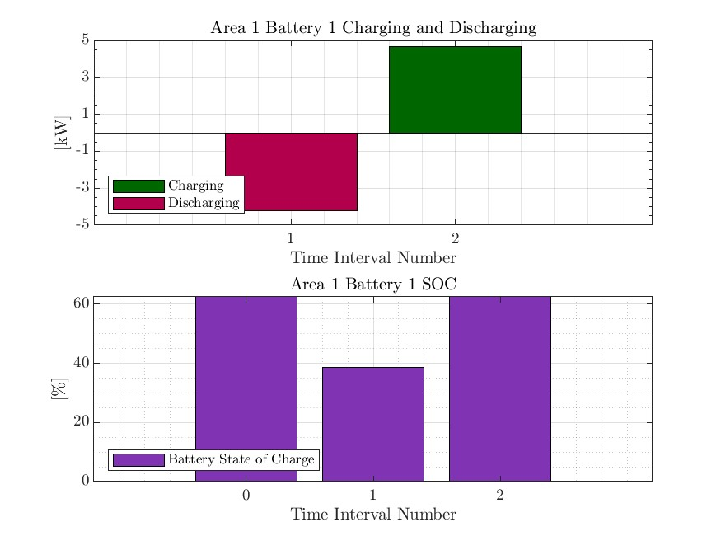
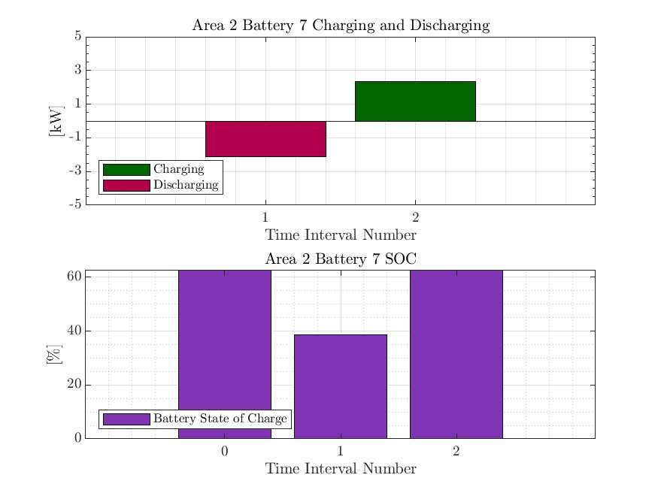



MPDOPF Verified for $T=2, PV=10\%, Batt=15\%$
strLoadShape = 'New Loadshape.LoadShape npts =2 interval = 1 mult = [1 0.7]'
strLoadShapePV = 'New Loadshape.LoadShapePV npts =2 interval = 1 mult = [1.4 0.8]'
Alternative Profiles

Slide 18




MPCOPF Verified for $T=2, PV=10\%, Batt=15\%$
strLoadShape = 'New Loadshape.LoadShape npts =2 interval = 1 mult = [1 0.7]'
strLoadShapePV = 'New Loadshape.LoadShapePV npts =2 interval = 1 mult = [1.4 0.8]'
Alternative Profiles

Slide 19
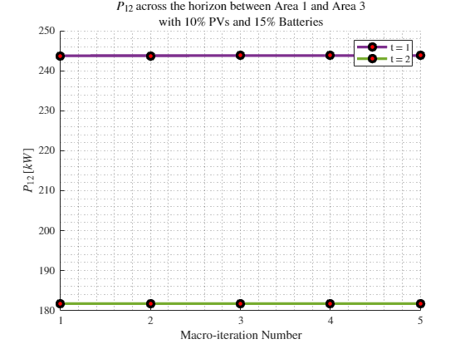
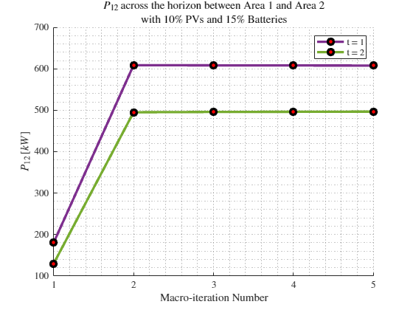
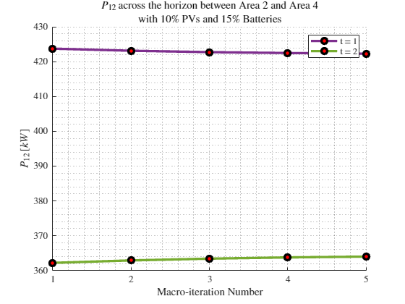

Boundary Complex Powers
strLoadShape = 'New Loadshape.LoadShape npts =2 interval = 1 mult = [1 0.7]'
MPDOPF Verified for $T=2, PV=10\%, Batt=15\%$
strLoadShapePV = 'New Loadshape.LoadShapePV npts =2 interval = 1 mult = [1.4 0.8]'
Alternative Profiles

Slide 20
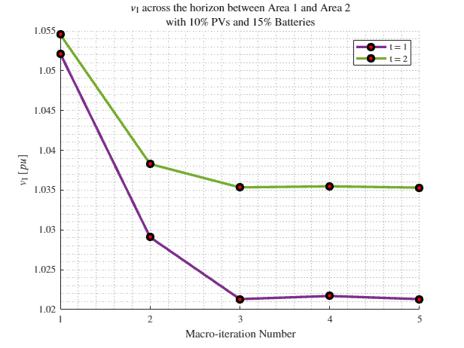
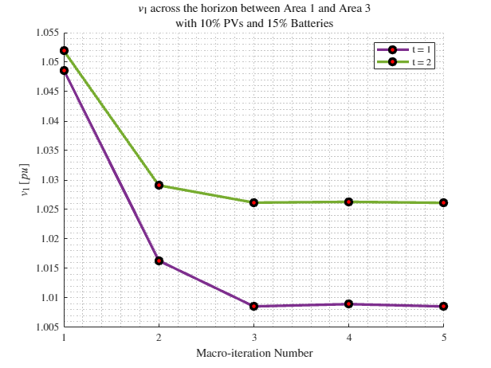
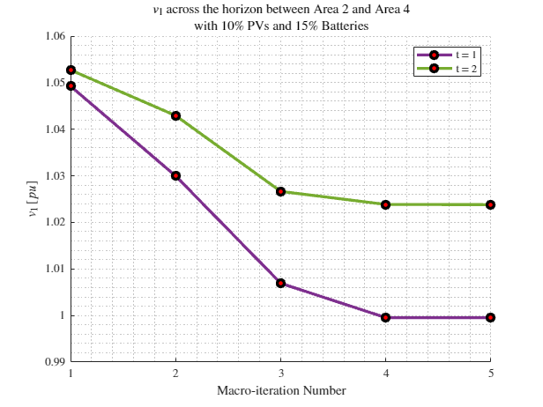
Boundary Voltages
strLoadShape = 'New Loadshape.LoadShape npts =2 interval = 1 mult = [1 0.7]'
MPDOPF Verified for $T=2, PV=10\%, Batt=15\%$
strLoadShapePV = 'New Loadshape.LoadShapePV npts =2 interval = 1 mult = [1.4 0.8]'
Alternative Profiles

Slide 21
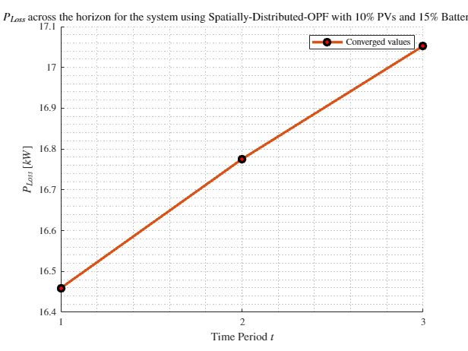
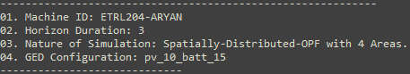
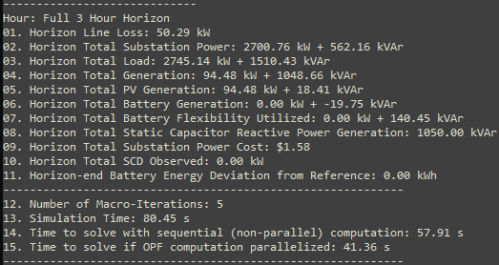
MPDOPF Verified for $T=3, PV=10\%, Batt=15\%$
strLoadShape = 'New Loadshape.LoadShape npts =3 interval = 1 mult = [0.777 0.787 0.796]'
strLoadShapePV = 'New Loadshape.LoadShapePV npts =3 interval = 1 mult = [0.8 0.9 1]'
MPDOPF Simulation Results
OpenDSS Powerflow Results
OpenDSS Def Profiles

Slide 22
MPCOPF Verified for $T=3, PV=10\%, Batt=15\%$
strLoadShape = 'New Loadshape.LoadShape npts =3 interval = 1 mult = [0.777 0.787 0.796]'
strLoadShapePV = 'New Loadshape.LoadShapePV npts =3 interval = 1 mult = [0.8 0.9 1]'
MPDOPF Simulation Results
OpenDSS Powerflow Results
OpenDSS Def Profiles

Slide 23



MPDOPF Verified for $T=3, PV=10\%, Batt=15\%$
strLoadShape = 'New Loadshape.LoadShape npts =3 interval = 1 mult = [0.777 0.787 0.796]'
strLoadShapePV = 'New Loadshape.LoadShapePV npts =3 interval = 1 mult = [0.8 0.9 1]'
OpenDSS Def Profiles

Slide 24
MPCOPF Verified for $T=3, PV=10\%, Batt=15\%$
strLoadShape = 'New Loadshape.LoadShape npts =3 interval = 1 mult = [0.777 0.787 0.796]'
strLoadShapePV = 'New Loadshape.LoadShapePV npts =3 interval = 1 mult = [0.8 0.9 1]'
OpenDSS Def Profiles

Slide 25
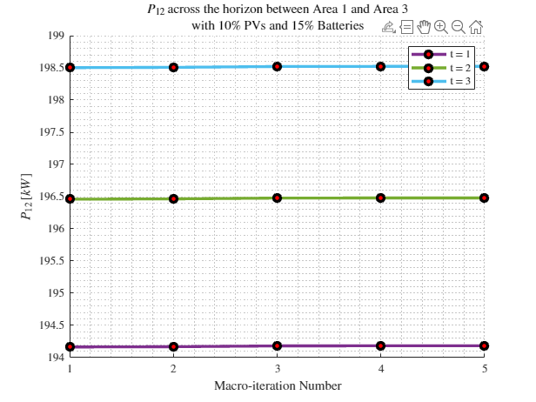



Boundary Complex Powers
strLoadShape = 'New Loadshape.LoadShape npts =3 interval = 1 mult = [0.777 0.787 0.796]'
MPDOPF Verified for $T=3, PV=10\%, Batt=15\%$
strLoadShapePV = 'New Loadshape.LoadShapePV npts =3 interval = 1 mult = [0.8 0.9 1]'
OpenDSS Def Profiles

Slide 26



Boundary Voltages
strLoadShape = 'New Loadshape.LoadShape npts =3 interval = 1 mult = [0.777 0.787 0.796]'
MPDOPF Verified for $T=3, PV=10\%, Batt=15\%$
strLoadShapePV = 'New Loadshape.LoadShapePV npts =3 interval = 1 mult = [0.8 0.9 1]'
OpenDSS Def Profiles

Slide 27




MPDOPF Verified for $T=3, PV=10\%, Batt=15\%$
strLoadShape = 'New Loadshape.LoadShape npts =3 interval = 1 mult = [0.7 1 0.7]'
strLoadShapePV = 'New Loadshape.LoadShapePV npts =3 interval = 1 mult = [0.8 1 0.8]'
MPDOPF Simulation Results
Alternative Profiles
OpenDSS Powerflow Results

Slide 28





MPCOPF Verified for $T=3, PV=10\%, Batt=15\%$
strLoadShape = 'New Loadshape.LoadShape npts =3 interval = 1 mult = [0.7 1 0.7]'
strLoadShapePV = 'New Loadshape.LoadShapePV npts =3 interval = 1 mult = [0.8 1 0.8]'
MPCOPF Simulation Results
Alternative Profiles
OpenDSS Powerflow Results

Slide 29




MPDOPF Verified for $T=3, PV=10\%, Batt=15\%$
strLoadShape = 'New Loadshape.LoadShape npts =3 interval = 1 mult = [0.7 1 0.7]'
strLoadShapePV = 'New Loadshape.LoadShapePV npts =3 interval = 1 mult = [0.8 1 0.8]'
Alternative Profiles

Slide 30



MPCOPF Verified for $T=3, PV=10\%, Batt=15\%$
strLoadShape = 'New Loadshape.LoadShape npts =3 interval = 1 mult = [0.7 1 0.7]'
strLoadShapePV = 'New Loadshape.LoadShapePV npts =3 interval = 1 mult = [0.8 1 0.8]'
Alternative Profiles

Slide 31



Boundary Complex Powers
strLoadShape = 'New Loadshape.LoadShape npts =3 interval = 1 mult = [0.7 1 0.7]'
MPDOPF Verified for $T=3, PV=10\%, Batt=15\%$
strLoadShapePV = 'New Loadshape.LoadShapePV npts =3 interval = 1 mult = [0.8 1 0.8]'
Alternative Profiles

Slide 32



Boundary Voltages
strLoadShape = 'New Loadshape.LoadShape npts =3 interval = 1 mult = [0.7 1 0.7]'
MPDOPF Verified for $T=3, PV=10\%, Batt=15\%$
strLoadShapePV = 'New Loadshape.LoadShapePV npts =3 interval = 1 mult = [0.8 1 0.8]'
Alternative Profiles

Slide 33





MPDOPF Verified for $T=5, PV=10\%, Batt=15\%$
strLoadShape = 'New Loadshape.LoadShape npts =5 interval = 1 mult = [0.75 0.777 0.787 0.796 0.782]'
strLoadShapePV = 'New Loadshape.LoadShapePV npts =5 interval = 1 mult = [0.5 0.8 0.9 1 1]'
MPDOPF Simulation Results
OpenDSS Powerflow Results

Slide 34





MPCOPF Verified for $T=5, PV=10\%, Batt=15\%$
strLoadShape = 'New Loadshape.LoadShape npts =5 interval = 1 mult = [0.75 0.777 0.787 0.796 0.782]'
strLoadShapePV = 'New Loadshape.LoadShapePV npts =5 interval = 1 mult = [0.5 0.8 0.9 1 1]'
MPCOPF Simulation Results
OpenDSS Powerflow Results

Slide 35




Boundary Complex Powers
MPDOPF Verified for $T=5, PV=10\%, Batt=15\%$

Slide 36



Boundary Voltages
MPDOPF Verified for $T=5, PV=10\%, Batt=15\%$

Slide 37




MPDOPF Verified for $T=5, PV=10\%, Batt=15\%$
strLoadShape = 'New Loadshape.LoadShape npts =5 interval = 1 mult = [0.7 0.85 1 0.85 0.7]'
strLoadShapePV = 'New Loadshape.LoadShapePV npts =5 interval = 1 mult = [1 1.2828 1.4 1.1 0.8]'
MPDOPF Simulation Results
Alternative Profiles
OpenDSS Powerflow Results

Slide 38




MPCOPF Verified for $T=5, PV=10\%, Batt=15\%$
strLoadShape = 'New Loadshape.LoadShape npts =5 interval = 1 mult = [0.7 0.85 1 0.85 0.7]'
strLoadShapePV = 'New Loadshape.LoadShapePV npts =5 interval = 1 mult = [1 1.2828 1.4 1.1 0.8]'
MPCOPF Simulation Results
Alternative Profiles
OpenDSS Powerflow Results

Slide 39




MPDOPF Verified for $T=5, PV=10\%, Batt=15\%$
strLoadShape = 'New Loadshape.LoadShape npts =5 interval = 1 mult = [0.7 0.85 1 0.85 0.7]'
strLoadShapePV = 'New Loadshape.LoadShapePV npts =5 interval = 1 mult = [1 1.2828 1.4 1.1 0.8]'
Alternative Profiles

Slide 40




MPCOPF Verified for $T=5, PV=10\%, Batt=15\%$
strLoadShape = 'New Loadshape.LoadShape npts =5 interval = 1 mult = [0.7 0.85 1 0.85 0.7]'
strLoadShapePV = 'New Loadshape.LoadShapePV npts =5 interval = 1 mult = [1 1.2828 1.4 1.1 0.8]'
Alternative Profiles

Slide 41



Boundary Complex Powers
strLoadShape = 'New Loadshape.LoadShape npts =5 interval = 1 mult = [0.7 0.85 1 0.85 0.7]'
MPDOPF Verified for $T=5, PV=10\%, Batt=15\%$
strLoadShapePV = 'New Loadshape.LoadShapePV npts =5 interval = 1 mult = [1 1.2828 1.4 1.1 0.8]'
Alternative Profiles

Slide 42



Boundary Voltages
strLoadShape = 'New Loadshape.LoadShape npts =5 interval = 1 mult = [0.7 0.85 1 0.85 0.7]'
MPDOPF Verified for $T=5, PV=10\%, Batt=15\%$
strLoadShapePV = 'New Loadshape.LoadShapePV npts =5 interval = 1 mult = [1 1.2828 1.4 1.1 0.8]'
Alternative Profiles

Slide 43


MPDOPF Verified for $T=8, PV=10\%, Batt=15\%$
strLoadShape = 'New Loadshape.LoadShape npts =8 interval = 1 mult = [0.705 0.75 0.777 0.787 0.796 0.782 0.783 0.789]'
strLoadShapePV = 'New Loadshape.LoadShapePV npts =8 interval = 1 mult = [0.3 0.5 0.8 0.9 1 1 0.99 0.9]'
MPDOPF Simulation Results
OpenDSS Powerflow Results

Slide 44





MPCOPF Verified for $T=8, PV=10\%, Batt=15\%$
strLoadShape = 'New Loadshape.LoadShape npts =8 interval = 1 mult = [0.705 0.75 0.777 0.787 0.796 0.782 0.783 0.789]'
strLoadShapePV = 'New Loadshape.LoadShapePV npts =8 interval = 1 mult = [0.3 0.5 0.8 0.9 1 1 0.99 0.9]'
MPCOPF Simulation Results
OpenDSS Powerflow Results

Slide 45

MPDOPF Verified for $T=8, PV=10\%, Batt=15\%$
strLoadShape = 'New Loadshape.LoadShape npts =8 interval = 1 mult = [0.705 0.75 0.777 0.787 0.796 0.782 0.783 0.789]'
1, 5, 7, 8 in COPF values
strLoadShapePV = 'New Loadshape.LoadShapePV npts =8 interval = 1 mult = [0.3 0.5 0.8 0.9 1 1 0.99 0.9]'

Slide 46





MPCOPF Verified for $T=8, PV=10\%, Batt=15\%$
strLoadShape = 'New Loadshape.LoadShape npts =8 interval = 1 mult = [0.705 0.75 0.777 0.787 0.796 0.782 0.783 0.789]'
strLoadShapePV = 'New Loadshape.LoadShapePV npts =8 interval = 1 mult = [0.3 0.5 0.8 0.9 1 1 0.99 0.9]'

Slide 47




Boundary Complex Powers
strLoadShape = 'New Loadshape.LoadShape npts =8 interval = 1 mult = [0.705 0.75 0.777 0.787 0.796 0.782 0.783 0.789]'
MPDOPF Verified for $T=8, PV=10\%, Batt=15\%$
strLoadShapePV = 'New Loadshape.LoadShapePV npts =8 interval = 1 mult = [0.3 0.5 0.8 0.9 1 1 0.99 0.9]'

Slide 48



Boundary Voltages
strLoadShape = 'New Loadshape.LoadShape npts =8 interval = 1 mult = [0.705 0.75 0.777 0.787 0.796 0.782 0.783 0.789]'
MPDOPF Verified for $T=8, PV=10\%, Batt=15\%$
strLoadShapePV = 'New Loadshape.LoadShapePV npts =8 interval = 1 mult = [0.3 0.5 0.8 0.9 1 1 0.99 0.9]'

Slide 49





MPDOPF Verified for $T=9, PV=10\%, Batt=15\%$
strLoadShape = 'New Loadshape.LoadShape npts =9 interval = 1 mult = [0.668 0.705 0.75 0.777 0.787 0.796 0.782 0.783 0.789]'
strLoadShapePV = 'New Loadshape.LoadShapePV npts =9 interval = 1 mult = [0.2 0.3 0.5 0.8 0.9 1 1 0.99 0.9]'
MPDOPF Simulation Results
OpenDSS Powerflow Results

Slide 50





MPCOPF Verified for $T=9, PV=10\%, Batt=15\%$
strLoadShape = 'New Loadshape.LoadShape npts =9 interval = 1 mult = [0.668 0.705 0.75 0.777 0.787 0.796 0.782 0.783 0.789]'
strLoadShapePV = 'New Loadshape.LoadShapePV npts =9 interval = 1 mult = [0.2 0.3 0.5 0.8 0.9 1 1 0.99 0.9]'
MPCOPF Simulation Results
OpenDSS Powerflow Results

Slide 51








MPDOPF Verified for $T=9, PV=10\%, Batt=15\%$
strLoadShape = 'New Loadshape.LoadShape npts =9 interval = 1 mult = [0.668 0.705 0.75 0.777 0.787 0.796 0.782 0.783 0.789]'
strLoadShapePV = 'New Loadshape.LoadShapePV npts =9 interval = 1 mult = [0.2 0.3 0.5 0.8 0.9 1 1 0.99 0.9]'

Slide 52








MPCOPF Verified for $T=9, PV=10\%, Batt=15\%$
strLoadShape = 'New Loadshape.LoadShape npts =9 interval = 1 mult = [0.668 0.705 0.75 0.777 0.787 0.796 0.782 0.783 0.789]'
strLoadShapePV = 'New Loadshape.LoadShapePV npts =9 interval = 1 mult = [0.2 0.3 0.5 0.8 0.9 1 1 0.99 0.9]'

Slide 53




Boundary Complex Powers
strLoadShape = 'New Loadshape.LoadShape npts =9 interval = 1 mult = [0.668 0.705 0.75 0.777 0.787 0.796 0.782 0.783 0.789]'
MPDOPF Verified for $T=9, PV=10\%, Batt=15\%$
strLoadShapePV = 'New Loadshape.LoadShapePV npts =9 interval = 1 mult = [0.2 0.3 0.5 0.8 0.9 1 1 0.99 0.9]'

Slide 54



Boundary Voltages
strLoadShape = 'New Loadshape.LoadShape npts =9 interval = 1 mult = [0.668 0.705 0.75 0.777 0.787 0.796 0.782 0.783 0.789]'
MPDOPF Verified for $T=9, PV=10\%, Batt=15\%$
strLoadShapePV = 'New Loadshape.LoadShapePV npts =9 interval = 1 mult = [0.2 0.3 0.5 0.8 0.9 1 1 0.99 0.9]'

Slide 55





MPDOPF Verified for $T=10, PV=10\%, Batt=15\%$
strLoadShape = 'New Loadshape.LoadShape npts =10 interval = 1 mult = [0.668 0.705 0.75 0.777 0.787 0.796 0.782 0.783 0.789 0.826]'
strLoadShapePV = 'New Loadshape.LoadShapePV npts =10 interval = 1 mult = [0.2 0.3 0.5 0.8 0.9 1 1 0.99 0.9 0.7]'
MPDOPF Simulation Results
OpenDSS Powerflow Results

Slide 56





MPCOPF Verified for $T=10, PV=10\%, Batt=15\%$
strLoadShape = 'New Loadshape.LoadShape npts =10 interval = 1 mult = [0.668 0.705 0.75 0.777 0.787 0.796 0.782 0.783 0.789 0.826]'
strLoadShapePV = 'New Loadshape.LoadShapePV npts =10 interval = 1 mult = [0.2 0.3 0.5 0.8 0.9 1 1 0.99 0.9 0.7]'
MPCOPF Simulation Results
OpenDSS Powerflow Results

Slide 57





MPDOPF Verified for $T=10, PV=10\%, Batt=15\%$
strLoadShape = 'New Loadshape.LoadShape npts =10 interval = 1 mult = [0.668 0.705 0.75 0.777 0.787 0.796 0.782 0.783 0.789 0.826]'
strLoadShapePV = 'New Loadshape.LoadShapePV npts =10 interval = 1 mult = [0.2 0.3 0.5 0.8 0.9 1 1 0.99 0.9 0.7]'

Slide 58





MPCOPF Verified for $T=10, PV=10\%, Batt=15\%$
strLoadShape = 'New Loadshape.LoadShape npts =10 interval = 1 mult = [0.668 0.705 0.75 0.777 0.787 0.796 0.782 0.783 0.789 0.826]'
strLoadShapePV = 'New Loadshape.LoadShapePV npts =10 interval = 1 mult = [0.2 0.3 0.5 0.8 0.9 1 1 0.99 0.9 0.7]'

Slide 59




Boundary Complex Powers
MPDOPF Verified for $T=10, PV=10\%, Batt=15\%$

Slide 60



Boundary Voltages
MPDOPF Verified for $T=10, PV=10\%, Batt=15\%$

Slide 61





MPDOPF Verified for $T=11, PV=10\%, Batt=15\%$
strLoadShape = 'New Loadshape.LoadShape npts =11 interval = 1 mult = [0.644 0.668 0.705 0.75 0.777 0.787 0.796 0.782 0.783 0.789 0.826]'
strLoadShapePV = 'New Loadshape.LoadShapePV npts =11 interval = 1 mult = [0.1 0.2 0.3 0.5 0.8 0.9 1 1 0.99 0.9 0.7]'
MPDOPF Simulation Results
OpenDSS Powerflow Results
OpenDSS Def Profiles

Slide 62

MPCOPF Verified for $T=11, PV=10\%, Batt=15\%$
strLoadShape = 'New Loadshape.LoadShape npts =11 interval = 1 mult = [0.644 0.668 0.705 0.75 0.777 0.787 0.796 0.782 0.783 0.789 0.826]'
strLoadShapePV = 'New Loadshape.LoadShapePV npts =11 interval = 1 mult = [0.1 0.2 0.3 0.5 0.8 0.9 1 1 0.99 0.9 0.7]'
MPDOPF Simulation Results
OpenDSS Powerflow Results
OpenDSS Def Profiles

Slide 63





MPDOPF Verified for $T=11, PV=10\%, Batt=15\%$
strLoadShape = 'New Loadshape.LoadShape npts =11 interval = 1 mult = [0.644 0.668 0.705 0.75 0.777 0.787 0.796 0.782 0.783 0.789 0.826]'
strLoadShapePV = 'New Loadshape.LoadShapePV npts =11 interval = 1 mult = [0.1 0.2 0.3 0.5 0.8 0.9 1 1 0.99 0.9 0.7]'
OpenDSS Def Profiles

Slide 64

MPCOPF Verified for $T=11, PV=10\%, Batt=15\%$
strLoadShape = 'New Loadshape.LoadShape npts =11 interval = 1 mult = [0.644 0.668 0.705 0.75 0.777 0.787 0.796 0.782 0.783 0.789 0.826]'
strLoadShapePV = 'New Loadshape.LoadShapePV npts =11 interval = 1 mult = [0.1 0.2 0.3 0.5 0.8 0.9 1 1 0.99 0.9 0.7]'
OpenDSS Def Profiles

Slide 65




Boundary Complex Powers
strLoadShape = 'New Loadshape.LoadShape npts =11 interval = 1 mult = [0.644 0.668 0.705 0.75 0.777 0.787 0.796 0.782 0.783 0.789 0.826]'
MPDOPF Verified for $T=11, PV=10\%, Batt=15\%$
strLoadShapePV = 'New Loadshape.LoadShapePV npts =11 interval = 1 mult = [0.1 0.2 0.3 0.5 0.8 0.9 1 1 0.99 0.9 0.7]'
OpenDSS Def Profiles

Slide 66



Boundary Voltages
strLoadShape = 'New Loadshape.LoadShape npts =11 interval = 1 mult = [0.644 0.668 0.705 0.75 0.777 0.787 0.796 0.782 0.783 0.789 0.826]'
MPDOPF Verified for $T=11, PV=10\%, Batt=15\%$
strLoadShapePV = 'New Loadshape.LoadShapePV npts =11 interval = 1 mult = [0.1 0.2 0.3 0.5 0.8 0.9 1 1 0.99 0.9 0.7]'
OpenDSS Def Profiles

Slide 67





MPDOPF Verified for $T=12, PV=10\%, Batt=15\%$
strLoadShape = 'New Loadshape.LoadShape npts =12 interval = 1 mult = [0.644 0.668 0.705 0.75 0.777 0.787 0.796 0.782 0.783 0.789 0.826 0.855]'
strLoadShapePV = 'New Loadshape.LoadShapePV npts =12 interval = 1 mult = [0.1 0.2 0.3 0.5 0.8 0.9 1 1 0.99 0.9 0.7 0.4]'
MPDOPF Simulation Results
OpenDSS Powerflow Results
OpenDSS Def Profiles

Slide 68





MPCOPF Verified for $T=12, PV=10\%, Batt=15\%$
strLoadShape = 'New Loadshape.LoadShape npts =12 interval = 1 mult = [0.644 0.668 0.705 0.75 0.777 0.787 0.796 0.782 0.783 0.789 0.826 0.855]'
strLoadShapePV = 'New Loadshape.LoadShapePV npts =12 interval = 1 mult = [0.1 0.2 0.3 0.5 0.8 0.9 1 1 0.99 0.9 0.7 0.4]'
MPDOPF Simulation Results
OpenDSS Powerflow Results
OpenDSS Def Profiles

Slide 69





MPDOPF Verified for $T=12, PV=10\%, Batt=15\%$
strLoadShape = 'New Loadshape.LoadShape npts =12 interval = 1 mult = [0.644 0.668 0.705 0.75 0.777 0.787 0.796 0.782 0.783 0.789 0.826 0.855]'
strLoadShapePV = 'New Loadshape.LoadShapePV npts =12 interval = 1 mult = [0.1 0.2 0.3 0.5 0.8 0.9 1 1 0.99 0.9 0.7 0.4]'
OpenDSS Def Profiles

Slide 70

MPCOPF Verified for $T=12, PV=10\%, Batt=15\%$
strLoadShape = 'New Loadshape.LoadShape npts =12 interval = 1 mult = [0.644 0.668 0.705 0.75 0.777 0.787 0.796 0.782 0.783 0.789 0.826 0.855]'
strLoadShapePV = 'New Loadshape.LoadShapePV npts =12 interval = 1 mult = [0.1 0.2 0.3 0.5 0.8 0.9 1 1 0.99 0.9 0.7 0.4]'
OpenDSS Def Profiles

Slide 71




Boundary Complex Powers
strLoadShape = 'New Loadshape.LoadShape npts =12 interval = 1 mult = [0.644 0.668 0.705 0.75 0.777 0.787 0.796 0.782 0.783 0.789 0.826 0.855]'
MPDOPF Verified for $T=12, PV=10\%, Batt=15\%$
strLoadShapePV = 'New Loadshape.LoadShapePV npts =12 interval = 1 mult = [0.1 0.2 0.3 0.5 0.8 0.9 1 1 0.99 0.9 0.7 0.4]'
OpenDSS Def Profiles

Slide 72



Boundary Voltages
strLoadShape = 'New Loadshape.LoadShape npts =12 interval = 1 mult = [0.644 0.668 0.705 0.75 0.777 0.787 0.796 0.782 0.783 0.789 0.826 0.855]'
MPDOPF Verified for $T=12, PV=10\%, Batt=15\%$
strLoadShapePV = 'New Loadshape.LoadShapePV npts =12 interval = 1 mult = [0.1 0.2 0.3 0.5 0.8 0.9 1 1 0.99 0.9 0.7 0.4]'
OpenDSS Def Profiles

Slide 73





MPDOPF Verified for $T=16, PV=10\%, Batt=15\%$
strLoadShape = 'New Loadshape.LoadShape npts =16 interval = 1 mult = [0.598 0.613 0.644 0.668 0.705 0.75 0.777 0.787 0.796 0.782 0.783 0.789 0.826 0.855 0.95 1]'
strLoadShapePV = 'New Loadshape.LoadShapePV npts =16 interval = 1 mult = [0 0 0.1 0.2 0.3 0.5 0.8 0.9 1 1 0.99 0.9 0.7 0.4 0.1 0]'
MPDOPF Simulation Results
OpenDSS Powerflow Results
OpenDSS Def Profiles

Slide 74





MPDOPF Verified for $T=16, PV=10\%, Batt=15\%$
strLoadShape = 'New Loadshape.LoadShape npts =16 interval = 1 mult = [0.598 0.613 0.644 0.668 0.705 0.75 0.777 0.787 0.796 0.782 0.783 0.789 0.826 0.855 0.95 1]'
strLoadShapePV = 'New Loadshape.LoadShapePV npts =16 interval = 1 mult = [0 0 0.1 0.2 0.3 0.5 0.8 0.9 1 1 0.99 0.9 0.7 0.4 0.1 0]'
OpenDSS Def Profiles

Slide 75




Boundary Complex Powers
strLoadShape = 'New Loadshape.LoadShape npts =16 interval = 1 mult = [0.598 0.613 0.644 0.668 0.705 0.75 0.777 0.787 0.796 0.782 0.783 0.789 0.826 0.855 0.95 1]'
MPDOPF Verified for $T=16, PV=10\%, Batt=15\%$
strLoadShapePV = 'New Loadshape.LoadShapePV npts =16 interval = 1 mult = [0 0 0.1 0.2 0.3 0.5 0.8 0.9 1 1 0.99 0.9 0.7 0.4 0.1 0]'
OpenDSS Def Profiles

Slide 76



Boundary Voltages
strLoadShape = 'New Loadshape.LoadShape npts =16 interval = 1 mult = [0.598 0.613 0.644 0.668 0.705 0.75 0.777 0.787 0.796 0.782 0.783 0.789 0.826 0.855 0.95 1]'
MPDOPF Verified for $T=16, PV=10\%, Batt=15\%$
strLoadShapePV = 'New Loadshape.LoadShapePV npts =16 interval = 1 mult = [0 0 0.1 0.2 0.3 0.5 0.8 0.9 1 1 0.99 0.9 0.7 0.4 0.1 0]'
OpenDSS Def Profiles

Slide 77
MPDOPF Verified for $T=3, PV=10\%, Batt=15\%$
strLoadShape = 'New Loadshape.LoadShape npts =11 interval = 1 mult = [0.644 0.668 0.705 0.75 0.777 0.787 0.796 0.782 0.783 0.789 0.826]'
strLoadShapePV = 'New Loadshape.LoadShapePV npts =11 interval = 1 mult = [0.1 0.2 0.3 0.5 0.8 0.9 1 1 0.99 0.9 0.7]'
MPDOPF Simulation Results
OpenDSS Powerflow Results
OpenDSS Def Profiles

Slide 78
MPCOPF Verified for $T=3, PV=10\%, Batt=15\%$
MPDOPF Simulation Results
OpenDSS Powerflow Results
OpenDSS Def Profiles

Slide 79
MPDOPF Verified for $T=3, PV=10\%, Batt=15\%$
OpenDSS Def Profiles

Slide 80
MPCOPF Verified for $T=3, PV=10\%, Batt=15\%$
OpenDSS Def Profiles

Slide 81
Boundary Complex Powers
MPDOPF Verified for $T=3, PV=10\%, Batt=15\%$
OpenDSS Def Profiles

Slide 82
Boundary Voltages
MPDOPF Verified for $T=3, PV=10\%, Batt=15\%$
OpenDSS Def Profiles

Slide 83
MPDOPF Verified for $T=5, PV=10\%, Batt=15\%$
strLoadShape = 'New Loadshape.LoadShape npts =5 interval = 1 mult = [0.75 0.777 0.787 0.796 0.782]'
strLoadShapePV = 'New Loadshape.LoadShapePV npts =5 interval = 1 mult = [0.5 0.8 0.9 1 1]'
MPDOPF Simulation Results
OpenDSS Powerflow Results

Slide 84
MPCOPF Verified for $T=5, PV=10\%, Batt=15\%$
strLoadShape = 'New Loadshape.LoadShape npts =5 interval = 1 mult = [0.75 0.777 0.787 0.796 0.782]'
strLoadShapePV = 'New Loadshape.LoadShapePV npts =5 interval = 1 mult = [0.5 0.8 0.9 1 1]'
MPCOPF Simulation Results
OpenDSS Powerflow Results

Slide 85



MPDOPF Verified for $T=10, PV=10\%, Batt=15\%$
strLoadShape = 'New Loadshape.LoadShape npts =10 interval = 1 mult = [0.668 0.705 0.75 0.777 0.787 0.796 0.782 0.783 0.789 0.826]'
strLoadShapePV = 'New Loadshape.LoadShapePV npts =10 interval = 1 mult = [0.2 0.3 0.5 0.8 0.9 1 1 0.99 0.9 0.7]'

Slide 86

MPCOPF Verified for $T=10, PV=10\%, Batt=15\%$
strLoadShape = 'New Loadshape.LoadShape npts =10 interval = 1 mult = [0.668 0.705 0.75 0.777 0.787 0.796 0.782 0.783 0.789 0.826]'
strLoadShapePV = 'New Loadshape.LoadShapePV npts =10 interval = 1 mult = [0.2 0.3 0.5 0.8 0.9 1 1 0.99 0.9 0.7]'

Slide 87
Boundary Complex Powers
strLoadShape = 'New Loadshape.LoadShape npts =10 interval = 1 mult = [0.668 0.705 0.75 0.777 0.787 0.796 0.782 0.783 0.789 0.826]'
MPDOPF Verified for $T=5, PV=10\%, Batt=15\%$
strLoadShapePV = 'New Loadshape.LoadShapePV npts =10 interval = 1 mult = [0.2 0.3 0.5 0.8 0.9 1 1 0.99 0.9 0.7]'

Slide 88
Boundary Voltages
strLoadShape = 'New Loadshape.LoadShape npts =10 interval = 1 mult = [0.668 0.705 0.75 0.777 0.787 0.796 0.782 0.783 0.789 0.826]'
MPDOPF Verified for $T=5, PV=10\%, Batt=15\%$
strLoadShapePV = 'New Loadshape.LoadShapePV npts =10 interval = 1 mult = [0.2 0.3 0.5 0.8 0.9 1 1 0.99 0.9 0.7]'

Slide 89





MPDOPF Verified for $T=1, PV=10\%, Batt=0\%$
strLoadShape = 'New Loadshape.LoadShape npts =1 interval = 1 mult = [0.787]'
strLoadShapePV = 'New Loadshape.LoadShapePV npts =1 interval = 1 mult = [0.9]'
MPDOPF Simulation Results
OpenDSS Powerflow Results

Slide 90





MPCOPF Verified for $T=1, PV=10\%, Batt=0\%$
strLoadShape = 'New Loadshape.LoadShape npts =1 interval = 1 mult = [0.787]'
strLoadShapePV = 'New Loadshape.LoadShapePV npts =1 interval = 1 mult = [0.9]'
MPCOPF Simulation Results
OpenDSS Powerflow Results

Slide 91





MPDOPF Verified for $T=1, PV=10\%, Batt=15\%$
strLoadShape = 'New Loadshape.LoadShape npts =1 interval = 1 mult = [0.787]'
strLoadShapePV = 'New Loadshape.LoadShapePV npts =1 interval = 1 mult = [0.9]'
MPDOPF Simulation Results
OpenDSS Powerflow Results

Slide 92





MPCOPF Verified for $T=1, PV=10\%, Batt=15\%$
strLoadShape = 'New Loadshape.LoadShape npts =1 interval = 1 mult = [0.787]'
strLoadShapePV = 'New Loadshape.LoadShapePV npts =1 interval = 1 mult = [0.9]'
MPCOPF Simulation Results
OpenDSS Powerflow Results

Slide 93





MPDOPF Verified for $T=2, PV=10\%, Batt=15\%$
strLoadShape = 'New Loadshape.LoadShape npts =2 interval = 1 mult = [0.787 0.796]'
strLoadShapePV = 'New Loadshape.LoadShapePV npts =2 interval = 1 mult = [0.9 1]'
MPDOPF Simulation Results
OpenDSS Powerflow Results

Slide 94





MPCOPF Verified for $T=2, PV=10\%, Batt=15\%$
strLoadShape = 'New Loadshape.LoadShape npts =2 interval = 1 mult = [0.787 0.796]'
strLoadShapePV = 'New Loadshape.LoadShapePV npts =2 interval = 1 mult = [0.9 1]'
MPCOPF Simulation Results
OpenDSS Powerflow Results

Slide 95

MPDOPF Verified for $T=3, PV=10\%, Batt=15\%$
strLoadShape = 'New Loadshape.LoadShape npts =3 interval = 1 mult = [0.777 0.787 0.796]'
strLoadShapePV = 'New Loadshape.LoadShapePV npts =3 interval = 1 mult = [0.8 0.9 1]'
MPDOPF Simulation Results
OpenDSS Powerflow Results

Slide 96




MPCOPF Verified for $T=3, PV=10\%, Batt=15\%$
strLoadShape = 'New Loadshape.LoadShape npts =3 interval = 1 mult = [0.777 0.787 0.796]'
strLoadShapePV = 'New Loadshape.LoadShapePV npts =3 interval = 1 mult = [0.8 0.9 1]'
MPCOPF Simulation Results
OpenDSS Powerflow Results

Slide 97




MPDOPF Verified for $T=5, PV=10\%, Batt=15\%$
strLoadShape = 'New Loadshape.LoadShape npts =5 interval = 1 mult = [0.75 0.777 0.787 0.796 0.782]'
strLoadShapePV = 'New Loadshape.LoadShapePV npts =5 interval = 1 mult = [0.5 0.8 0.9 1 1]'
MPDOPF Simulation Results
OpenDSS Powerflow Results

Slide 98




MPCOPF Verified for $T=5, PV=10\%, Batt=15\%$
strLoadShape = 'New Loadshape.LoadShape npts =5 interval = 1 mult = [0.75 0.777 0.787 0.796 0.782]'
strLoadShapePV = 'New Loadshape.LoadShapePV npts =5 interval = 1 mult = [0.5 0.8 0.9 1 1]'
MPCOPF Simulation Results
OpenDSS Powerflow Results

Slide 99





MPDOPF Verified for $T=5, PV=10\%, Batt=15\%$
strLoadShape = 'New Loadshape.LoadShape npts =5 interval = 1 mult = [0.75 0.777 0.787 0.796 0.782]'
strLoadShapePV = 'New Loadshape.LoadShapePV npts =5 interval = 1 mult = [0.5 0.8 0.9 1 1]'

Slide 100





MPCOPF Verified for $T=5, PV=10\%, Batt=15\%$
strLoadShape = 'New Loadshape.LoadShape npts =5 interval = 1 mult = [0.75 0.777 0.787 0.796 0.782]'
strLoadShapePV = 'New Loadshape.LoadShapePV npts =5 interval = 1 mult = [0.5 0.8 0.9 1 1]'

Slide 101



Boundary Complex Powers
MPDOPF Verified for $T=5, PV=10\%, Batt=15\%$

Slide 102



Boundary Voltages
MPDOPF Verified for $T=5, PV=10\%, Batt=15\%$

Slide 103




MPDOPF Verified for $T=10, PV=10\%, Batt=15\%$
strLoadShape = 'New Loadshape.LoadShape npts =10 interval = 1 mult = [0.668 0.705 0.75 0.777 0.787 0.796 0.782 0.783 0.789 0.826]'
strLoadShapePV = 'New Loadshape.LoadShapePV npts =10 interval = 1 mult = [0.2 0.3 0.5 0.8 0.9 1 1 0.99 0.9 0.7]'
MPDOPF Simulation Results
OpenDSS Powerflow Results

Slide 104




MPCOPF Verified for $T=10, PV=10\%, Batt=15\%$
strLoadShape = 'New Loadshape.LoadShape npts =10 interval = 1 mult = [0.668 0.705 0.75 0.777 0.787 0.796 0.782 0.783 0.789 0.826]'
strLoadShapePV = 'New Loadshape.LoadShapePV npts =10 interval = 1 mult = [0.2 0.3 0.5 0.8 0.9 1 1 0.99 0.9 0.7]'
MPCOPF Simulation Results
OpenDSS Powerflow Results

Slide 105





MPDOPF Verified for $T=10, PV=10\%, Batt=15\%$
strLoadShape = 'New Loadshape.LoadShape npts =10 interval = 1 mult = [0.668 0.705 0.75 0.777 0.787 0.796 0.782 0.783 0.789 0.826]'
strLoadShapePV = 'New Loadshape.LoadShapePV npts =10 interval = 1 mult = [0.2 0.3 0.5 0.8 0.9 1 1 0.99 0.9 0.7]'

Slide 106





MPCOPF Verified for $T=10, PV=10\%, Batt=15\%$
strLoadShape = 'New Loadshape.LoadShape npts =10 interval = 1 mult = [0.668 0.705 0.75 0.777 0.787 0.796 0.782 0.783 0.789 0.826]'
strLoadShapePV = 'New Loadshape.LoadShapePV npts =10 interval = 1 mult = [0.2 0.3 0.5 0.8 0.9 1 1 0.99 0.9 0.7]'

Slide 107



Boundary Complex Powers
MPDOPF Verified for $T=10, PV=10\%, Batt=15\%$

Slide 108



Boundary Voltages
MPDOPF Verified for $T=10, PV=10\%, Batt=15\%$

Slide 109

MPDOPF Verified for $T=t, PV=10\%, Batt=15\%$
strLoadShape = 'New Loadshape.LoadShape npts =1 interval = 1 mult = [0.787]'
strLoadShapePV = 'New Loadshape.LoadShapePV npts =1 interval = 1 mult = [0.9]'
MPDOPF Simulation Results
OpenDSS Powerflow Results

Slide 110

MPCOPF Verified for $T=t, PV=10\%, Batt=15\%$
strLoadShape = 'New Loadshape.LoadShape npts =1 interval = 1 mult = [0.787]'
strLoadShapePV = 'New Loadshape.LoadShapePV npts =1 interval = 1 mult = [0.9]'
MPCOPF Simulation Results
OpenDSS Powerflow Results

Slide 111









MPDOPF Verified for $T=1, PV=10\%, Batt=10\%$
strLoadShape = 'New Loadshape.LoadShape npts =1 interval = 1 mult = [0.787]'
strLoadShapePV = 'New Loadshape.LoadShapePV npts =1 interval = 1 mult = [0.9]'
MPDOPF Simulation Results
OpenDSS Powerflow Results
$10\%$GED = $11$ buses

Slide 112








MPCOPF Verified for $T=1, PV=10\%, Batt=10\%$
strLoadShape = 'New Loadshape.LoadShape npts =1 interval = 1 mult = [0.787]'
strLoadShapePV = 'New Loadshape.LoadShapePV npts =1 interval = 1 mult = [0.9]'
MPCOPF Simulation Results
OpenDSS Powerflow Results
$10\%$GED = $11$ buses

Slide 113






MPDOPF Verified for $T=1, PV=100\%, Batt=100\%$
strLoadShape = 'New Loadshape.LoadShape npts =1 interval = 1 mult = [0.787]'
strLoadShapePV = 'New Loadshape.LoadShapePV npts =1 interval = 1 mult = [0.9]'
MPDOPF Simulation Results
OpenDSS Powerflow Results
$100\%$GED = $85$ buses

Slide 114





MPCOPF Verified for $T=1, PV=100\%, Batt=100\%$
strLoadShape = 'New Loadshape.LoadShape npts =1 interval = 1 mult = [0.787]'
strLoadShapePV = 'New Loadshape.LoadShapePV npts =1 interval = 1 mult = [0.9]'
MPCOPF Simulation Results
OpenDSS Powerflow Results
$100\%$GED = $85$ buses

Slide 115






MPDOPF Verified for $T=5, PV=10\%, Batt=10\%$
strLoadShape = 'New Loadshape.LoadShape npts =5 interval = 1 mult = [0.75 0.777 0.787 0.796 0.782]'
strLoadShapePV = 'New Loadshape.LoadShapePV npts =5 interval = 1 mult = [0.5 0.8 0.9 1 1]'
MPDOPF Simulation Results
OpenDSS Powerflow Results
$10\%$GED = $11$ buses

Slide 116






MPCOPF Verified for $T=5, PV=10\%, Batt=10\%$
strLoadShape = 'New Loadshape.LoadShape npts =5 interval = 1 mult = [0.75 0.777 0.787 0.796 0.782]'
strLoadShapePV = 'New Loadshape.LoadShapePV npts =5 interval = 1 mult = [0.5 0.8 0.9 1 1]'
MPCOPF Simulation Results
OpenDSS Powerflow Results
$10\%$GED = $9$ buses

Slide 117





MPDOPF Verified for $T=6, PV=10\%, Batt=10\%$
strLoadShape = 'New Loadshape.LoadShape npts =6 interval = 1 mult = [0.75 0.777 0.787 0.796 0.782 0.783]'
strLoadShapePV = 'New Loadshape.LoadShapePV npts =6 interval = 1 mult = [0.5 0.8 0.9 1 1 0.99]'
MPDOPF Simulation Results
OpenDSS Powerflow Results
$10\%$GED = $11$ buses

Slide 118





MPCOPF Verified for $T=6, PV=10\%, Batt=10\%$
strLoadShape = 'New Loadshape.LoadShape npts =6 interval = 1 mult = [0.75 0.777 0.787 0.796 0.782 0.783]'
strLoadShapePV = 'New Loadshape.LoadShapePV npts =6 interval = 1 mult = [0.5 0.8 0.9 1 1 0.99]'
MPCOPF Simulation Results
OpenDSS Powerflow Results
$10\%$GED = $9$ buses

Slide 119





MPDOPF Verified for $T=7, PV=10\%, Batt=10\%$
strLoadShape = 'New Loadshape.LoadShape npts =7 interval = 1 mult = [0.705 0.75 0.777 0.787 0.796 0.782 0.783]'
strLoadShapePV = 'New Loadshape.LoadShapePV npts =7 interval = 1 mult = [0.3 0.5 0.8 0.9 1 1 0.99]'
MPDOPF Simulation Results
OpenDSS Powerflow Results
$10\%$GED = $11$ buses

Slide 120





MPCOPF Verified for $T=7, PV=10\%, Batt=10\%$
strLoadShape = 'New Loadshape.LoadShape npts =7 interval = 1 mult = [0.705 0.75 0.777 0.787 0.796 0.782 0.783]'
strLoadShapePV = 'New Loadshape.LoadShapePV npts =7 interval = 1 mult = [0.3 0.5 0.8 0.9 1 1 0.99]'
MPCOPF Simulation Results
OpenDSS Powerflow Results
$10\%$GED = $9$ buses

Slide 121





MPDOPF Verified for $T=8, PV=10\%, Batt=10\%$
strLoadShape = 'New Loadshape.LoadShape npts =8 interval = 1 mult = [0.705 0.75 0.777 0.787 0.796 0.782 0.783 0.789]'
strLoadShapePV = 'New Loadshape.LoadShapePV npts =8 interval = 1 mult = [0.3 0.5 0.8 0.9 1 1 0.99 0.9]'
MPDOPF Simulation Results
OpenDSS Powerflow Results
$10\%$GED = $11$ buses

Slide 122





MPCOPF Verified for $T=8, PV=10\%, Batt=10\%$
strLoadShape = 'New Loadshape.LoadShape npts =8 interval = 1 mult = [0.705 0.75 0.777 0.787 0.796 0.782 0.783 0.789]'
strLoadShapePV = 'New Loadshape.LoadShapePV npts =8 interval = 1 mult = [0.3 0.5 0.8 0.9 1 1 0.99 0.9]'
MPCOPF Simulation Results
OpenDSS Powerflow Results
$10\%$GED = $9$ buses

Slide 123





MPDOPF Verified for $T=9, PV=10\%, Batt=10\%$
strLoadShape = 'New Loadshape.LoadShape npts =9 interval = 1 mult = [0.668 0.705 0.75 0.777 0.787 0.796 0.782 0.783 0.789]'
strLoadShapePV = 'New Loadshape.LoadShapePV npts =9 interval = 1 mult = [0.2 0.3 0.5 0.8 0.9 1 1 0.99 0.9]'
MPDOPF Simulation Results
OpenDSS Powerflow Results
$10\%$GED = $11$ buses

Slide 124





MPCOPF Verified for $T=9, PV=10\%, Batt=10\%$
strLoadShape = 'New Loadshape.LoadShape npts =9 interval = 1 mult = [0.668 0.705 0.75 0.777 0.787 0.796 0.782 0.783 0.789]'
strLoadShapePV = 'New Loadshape.LoadShapePV npts =9 interval = 1 mult = [0.2 0.3 0.5 0.8 0.9 1 1 0.99 0.9]'
MPCOPF Simulation Results
OpenDSS Powerflow Results
$10\%$GED = $9$ buses

Slide 125





MPDOPF Verified for $T=10, PV=10\%, Batt=10\%$
strLoadShape = 'New Loadshape.LoadShape npts =10 interval = 1 mult = [0.668 0.705 0.75 0.777 0.787 0.796 0.782 0.783 0.789 0.826]'
strLoadShapePV = 'New Loadshape.LoadShapePV npts =10 interval = 1 mult = [0.2 0.3 0.5 0.8 0.9 1 1 0.99 0.9 0.7]'
MPDOPF Simulation Results
OpenDSS Powerflow Results
$10\%$GED = $11$ buses

Slide 126





MPCOPF Verified for $T=10, PV=10\%, Batt=10\%$
strLoadShape = 'New Loadshape.LoadShape npts =10 interval = 1 mult = [0.668 0.705 0.75 0.777 0.787 0.796 0.782 0.783 0.789 0.826]'
strLoadShapePV = 'New Loadshape.LoadShapePV npts =10 interval = 1 mult = [0.2 0.3 0.5 0.8 0.9 1 1 0.99 0.9 0.7]'
MPCOPF Simulation Results
OpenDSS Powerflow Results
$10\%$GED = $9$ buses

Slide 127





MPDOPF Verified for $T=10, PV=10\%, Batt=10\%$
strLoadShape = 'New Loadshape.LoadShape npts =10 interval = 1 mult = [0.668 0.705 0.75 0.777 0.787 0.796 0.782 0.783 0.789 0.826]'
strLoadShapePV = 'New Loadshape.LoadShapePV npts =10 interval = 1 mult = [0.2 0.3 0.5 0.8 0.9 1 1 0.99 0.9 0.7]'

Slide 128



Boundary Complex Powers

Slide 129



Boundary Voltages

Slide 130





MPDOPF Verified for $T=11, PV=10\%, Batt=10\%$
strLoadShape = 'New Loadshape.LoadShape npts =11 interval = 1 mult = [0.644 0.668 0.705 0.75 0.777 0.787 0.796 0.782 0.783 0.789 0.826]'
strLoadShapePV = 'New Loadshape.LoadShapePV npts =11 interval = 1 mult = [0.1 0.2 0.3 0.5 0.8 0.9 1 1 0.99 0.9 0.7]'
MPDOPF Simulation Results
OpenDSS Powerflow Results
$10\%$GED = $11$ buses

Slide 131





MPCOPF Verified for $T=11, PV=10\%, Batt=10\%$
strLoadShape = 'New Loadshape.LoadShape npts =11 interval = 1 mult = [0.644 0.668 0.705 0.75 0.777 0.787 0.796 0.782 0.783 0.789 0.826]'
strLoadShapePV = 'New Loadshape.LoadShapePV npts =11 interval = 1 mult = [0.1 0.2 0.3 0.5 0.8 0.9 1 1 0.99 0.9 0.7]'
MPCOPF Simulation Results
OpenDSS Powerflow Results
$10\%$GED = $9$ buses

Slide 132


MPDOPF Verification: $$T=1, PV=30\%, Batt=30\%$$

Slide 133





MPDOPF Verified for $T=1, PV=30\%, Batt=30\%$
MPDOPF Simulation Results
OpenDSS Powerflow Results

Slide 134



MPDOPF Verification: $$T=2, PV=30\%, Batt=30\%$$

Slide 135






MPDOPF Verified for $T=2, PV=30\%, Batt=30\%$
MPDOPF Simulation Results
OpenDSS Powerflow Results

Slide 136




MPDOPF Verification: $$T=3, PV=10\%, Batt=10\%$$

Slide 137






MPDOPF Verified for $T=3, PV=10\%, Batt=10\%$
MPDOPF Simulation Results
OpenDSS Powerflow Results

Slide 138



MPDOPF Verification: $$T=4, PV=10\%, Batt=10\%$$

Slide 139






MPDOPF Verified for $T=4, PV=10\%, Batt=10\%$
strLoadShape = 'New Loadshape.LoadShape npts =4 interval = 1 mult = [0.777 0.787 0.796 0.782]'
strLoadShapePV = 'New Loadshape.LoadShapePV npts =4 interval = 1 mult = [0.8 0.9 1 1]'
MPDOPF Simulation Results
OpenDSS Powerflow Results

Slide 140



MPDOPF Verification: $$T=5, PV=10\%, Batt=10\%$$

Slide 141



MPDOPF Verification: $$T=5, PV=30\%, Batt=30\%$$

Slide 142





MPCOPF $T=5, PV=30\%, Batt=30\%$

Slide 143



MPDOPF Verification: $$T=5, PV=50\%, Batt=50\%$$

Slide 144





MPCOPF $T=5, PV=50\%, Batt=50\%$ sim terminated at 100 micro-iterations

Slide 145



MPDOPF Verification: $$T=5, PV=100\%, Batt=100\%$$

Slide 146



MPDOPF Verification: $$T=6, PV=10\%, Batt=10\%$$

Slide 147






MPDOPF Verified for $T=5, PV=30\%, Batt=30\%$
strLoadShape = 'New Loadshape.LoadShape npts =5 interval = 1 mult = [0.75 0.777 0.787 0.796 0.782]'
strLoadShapePV = 'New Loadshape.LoadShapePV npts =5 interval = 1 mult = [0.5 0.8 0.9 1 1]'
MPDOPF Simulation Results
OpenDSS Powerflow Results

Slide 148






MPDOPF Verified for $T=5, PV=50\%, Batt=50\%$
strLoadShape = 'New Loadshape.LoadShape npts =5 interval = 1 mult = [0.75 0.777 0.787 0.796 0.782]'
strLoadShapePV = 'New Loadshape.LoadShapePV npts =5 interval = 1 mult = [0.5 0.8 0.9 1 1]'
MPDOPF Simulation Results
OpenDSS Powerflow Results

Slide 149






MPDOPF Verified for $T=5, PV=100\%, Batt=100\%$
strLoadShape = 'New Loadshape.LoadShape npts =5 interval = 1 mult = [0.75 0.777 0.787 0.796 0.782]'
strLoadShapePV = 'New Loadshape.LoadShapePV npts =5 interval = 1 mult = [0.5 0.8 0.9 1 1]'
MPDOPF Simulation Results
OpenDSS Powerflow Results

Slide 150


MPDOPF: Mapping of Decentralized Variables to Centralized Variables done, everything packed into a structure suitable for OpenDSS Validation.
I had node numbers for $4$ Areas like $1:41$, $1:19, 1:20, 1:54$ but not a way to know which nodes do they refer to in the real ‘centralized’ system.
I (manually) created a mapping between the two.
I then used the mapping scheme to collate all ‘area information’ after optimization into a ‘system information’ for validating against OpenDSS.

Slide 151

How do other authors validate their OPF results?
[nazir2020tpwrs]
Feasibility of Solution: Forward-Backward Sweep in GridLab-D.
They check violation of node voltages between the simulation and the GridLab-D powerflow.
Optimality of Solution:
The authors argue that a) computing (even for verifying) Multi-Period NL OPF can be computationally too expensive and b) the solution to a ‘Decoupled’ NL-OPF (with battery set points already assigned by the Full Horizon SOCP OPF will provide an even lower optimal value compared to the Full Horizon NLP OPF (7).

Slide 152


How do other authors validate their OPF results?
[nazir2020tpwrs]
Optimality of Solution:
They formulate their optimality gap as a comparison between the SOCP optimal value and Decoupled NLP optimal value (9), for each time-step, and taking the maximum optimality gap to show as the result.
For IEEE 123, they get a maximum optimality gap of $2.1\%$. Violations against GridLab-D are small. (Feasible solution).

Slide 153

How do other authors validate their OPF results?
[nazir2020tpwrs]
Commentary on Solution Times:
Fig. (a) They see a similar trend in results as me when performing a Full Horizon NLP, with solution times becoming increasingly larger as the time-horizon increases.
Fig. (b) But their SOCP approach scales well, with solutions times increasingly almost linearly with time-horizon. For practical scenarios (day-ahead hourly simulation), their SOCP solution converges in under a minute.

Slide 154


How do other authors validate their OPF results?
[usman2022tpwrs]
Feasibility and Optimality of Solution:
They mainly showcase the benchmarks based on UK $31$ bus system.
They solve the full horizon (day-ahead hourly) OPF MINLP OPF in JuMP using BONMIN solver (here called $M0$).
They compare its objective function against their own linearized method (here called $M1$).
They get an optimality gap of less than $1\%$.
Infeasibilities are detected based on box-constraints (line-limits breached, bus voltage limits breached, etc.).

Slide 155
How do other authors validate their OPF results?
[agrawal2022tpwrs]
Other authors, sometimes use a different solution paradigm, and compare it against MATLAB’s fmincon.

Slide 156






MPCOPF Simulation has been verified for X% PVs and Y% Batteries Only for small horizons ($T≤8$) because of long simulation time.

Slide 157




$$T=1, PV=10\%, Batt=10\%$$

Slide 158





$$T=2, PV=10\%, Batt=10\%$$

Slide 159




$$T=2, PV=30\%, Batt=30\%$$

Slide 160





$$T=3, PV=10\%, Batt=10\%$$

Slide 161





$$T=4, PV=10\%, Batt=10\%$$

Slide 162





$$T=5, PV=10\%, Batt=10\%$$

Slide 163

$$T=5, PV=30\%, Batt=30\%$$

Slide 164


$$T=5, PV=30\%, Batt=30\%$$

Slide 165

$$T=5, PV=50\%, Batt=50\%$$ sim terminated at 100 micro-iterations

Slide 166


$$T=5, PV=50\%, Batt=50\%$$ sim terminated at 100 micro-iterations

Slide 167





$$T=6, PV=10\%, Batt=10\%$$

Slide 168


$$T=6, PV=10\%, Batt=10\%$$

Slide 169





$$T=7,PV=10\%, Batt=10\%$$

Slide 170





$$T=8,PV=10\%, Batt=10\%$$

Slide 171


$$T=8,PV=10\%, Batt=10\%$$

Slide 172





$$T=9,PV=10\%, Batt=10\%$$

Slide 173




$$T=1, PV=30\%, Batt=30\%$$

Slide 174





$$T=6, PV=30\%, Batt=30\%$$

Slide 175





$$T=6, PV=50\%, Batt=50\%$$

Slide 176

MPCOPF Simulation has been verified for X% PVs and Y% Batteries Only for small horizons ($T=5$) because of long simulation time.
MPCOPF Simulation Results
These slides will show results for a $5$-hour (hourly) $10\%$ PV $+ 10\%$Battery Simulation Validation for IEEE $123$ system, but I’ve validated for many other percentage penetrations too, for smaller time-steps.
For example, even this simulation took $500$ seconds on my $32$GB Office PC.
Even for the same $T$, increasing the GED penetration % increases the OPF solution time.
And even for small GED penetration percentage (10% each like the one done in these slides), increasing $T$ increases the simulation time by a lot.

Slide 177





MPCOPF Simulation has been verified for X% PVs and Y% Batteries Only for small horizons ($T≤5$) because of long simulation time.
MPCOPF Simulation Results
OpenDSS Powerflow Results
$10\%$ PVs + $10\%$ Batteries

Slide 178



Current Issue: Some mismatch in MPCOPF results Seeming mismatch between specified (from OPF) and assigned values (into OpenDSS) for Battery Reactive Powers

Slide 179




Currently Doing: Extracting Results on an Hourly (Time-step) Basis, for hourly comparison against OpenDSS

Slide 180





IEEE $123 X\%$PVs, $0\%$Batteries. COPF. $T = 1$
Objective Function values (Real Power Losses $P_{Loss}$) and System-wide Voltage snapshots (shown in the next slides) match.
This slide: $X=0$
Multi-Period Simulation, T = 1, Batteries at 0%, DERs at 0% ($0$ buses)
OpenDSS Powerflow with DERs at 0% ($0$ buses)

Slide 181




IEEE $123 X\%$PVs, $0\%$Batteries. COPF. $T = 1$
Objective Function values (Real Power Losses $P_{Loss}$) and System-wide Voltage snapshots (shown in the next slides) match.
This slide: $X=50$
Multi-Period Simulation, T = 1, Batteries at 0%, DERs at 50% ($43$ buses)
OpenDSS Powerflow with DERs at 50% ($43$ buses)

Slide 182




IEEE $123 X\%$PVs, $0\%$Batteries. COPF. $T = 1$
Objective Function values (Real Power Losses $P_{Loss}$) and System-wide Voltage snapshots (shown in the next slides) match.
This slide: $X=100$
Multi-Period Simulation, T = 1, Batteries at 0%, DERs at 100% ($85$ buses)
OpenDSS Powerflow with DERs at 100% ($85$ buses)

Slide 183







Comparison with OpenDSS: System-wide Voltage Snapshots PV = $0\%, 10\%, 20\%, 30\%, 40\%, 50\%$ Battery = $0\%$ $$T = 1$$

Slide 184






Comparison with OpenDSS: System-wide Voltage Snapshots PV = $60\%, 70\%, 80\%, 90\%, 100\%,$ Battery = $0\%$ $$T = 1$$

Slide 185






Comparison with OpenDSS: System-wide Voltage Snapshots Battery = $10\%, 20\%, 30\%, 40\%, 50\%$ PV = $0\%$ $$T = 1$$

Slide 186






Comparison with OpenDSS: System-wide Voltage Snapshots
PV = $0\%$ Battery = $60\%, 70\%, 80\%, 90\%, 100\%,$ $$T = 1$$

Slide 187






Comparison with OpenDSS: System-wide Voltage Snapshots
PV and Battery = $0\%, 10\%, 30\%, 50\%, 100\%$ $$T = 1$$

Slide 188





Trying to benchmark the “Benchmark” Simulation against the “Original” Simulation
$T$: Number of Time-Periods (tunable)
No Time-dimension: Equivalent to $T=1$
$numAreas$ : Number of Areas the system is divided into. The simulation becomes:
CMPOPF if $numAreas = 1$
DMPOPF if $numAreas > 1 (4)$
$numAreas$ : Number of Areas the system is divided into. The simulation becomes:
CMPOPF if $numAreas = 1$
DMPOPF if $numAreas > 1 (4)$
DERs (tunable): $[0, 100\%]$ ($0$ to $85$ buses)
Batteries# (tunable*): $[0, 100\%]$ ($0$ to $85$buses)
DERs (fixed): $100\%$ ($85$ buses)
No Batteries: Equivalent to $0\%$ ($0$ buses)
“Benchmark” Simulation: MP-(C/D)-OPF
“Original” Simulation: (C/D)-OPF

Slide 189








Trying to benchmark the “Benchmark” Simulation against the “Original” Simulation
#Batteries add more than just $4$ new decision variables (which are $B, P_{c}, P_{d}, q_{B}$) to the simulation.
Incorporating them (while avoiding mixed-integer programming) requires specifying additional ‘soft-constraint’ objective functions to the optimizer, including an “SCD penalty” function and a “Deviation of terminal SOC from a reference SOC penalty” function, which require additional unknown parameters (such as $α, γ$ in my simulation). Ideally, these ‘soft-constraint’ function values in the result should be zero, but if this doesn’t happen, they cannot be truly compared to a ‘battery-free’ simulation.
$T$: Number of Time-Periods (tunable)
No Time-dimension: Like $T=1$
$numAreas$ : Number of Areas the system is divided into. The simulation becomes:
CMPOPF if $numAreas = 1$
DMPOPF if $numAreas > 1 (4)$
$numAreas$ : Number of Areas the system is divided into. The simulation becomes:
CMPOPF if $numAreas = 1$
DMPOPF if $numAreas > 1 (4)$
DERs (tunable): $[0, 100\%]$ ($0$ to $85$ buses)
Batteries# (tunable*): $[0, 100\%]$ ($0$ to $85$buses)
DERs (fixed): $100\%$ ($85$ buses)
No Batteries: Like $0\%$ ($0$ buses)
“Benchmark” Simulation: MP-(C/D)-OPF
“Original” Simulation: (C/D)-OPF
*Note: The way the batteries are currently modeled, they can only be placed at a bus where there is already a DER. (So only $85$ buses are eligible to have a battery)

Slide 190







Trying to benchmark the “Benchmark” Simulation against the “Original” Simulation
But, if batteries are removed (unmodeled) from the MPOPF simulation, the previously mentioned complications are also avoided, and thus the two simulations can be compared toe-to-toe. This is what I’ve been doing recently.
$T$: Number of Time-Periods (tunable)
$$T=1$$
$numAreas=1$ (COPF)
$$\%DER=100$$
$$\%Batteries=0$$
No Time-dimension: Equivalent to $T=1$
$numAreas$ : Number of Areas the system is divided into. The simulation becomes:
CMPOPF if $numAreas = 1$
DMPOPF if $numAreas > 1 (4)$
$numAreas$ : Number of Areas the system is divided into. The simulation becomes:
CMPOPF if $numAreas = 1$
DMPOPF if $numAreas > 1 (4)$
DERs (tunable): $[0, 100\%]$ ($0$ to $85$ buses)
Batteries# (tunable*): $[0, 100\%]$ ($0$ to $85$buses)
DERs (fixed): $100\%$ ($85$ buses)
No Batteries: Equivalent to $0\%$ ($0$ buses)
“Benchmark” Simulation: MP-(C/D)-OPF
“Original” Simulation: (C/D)-OPF

Slide 191


IEEE $123 100\%$DER, $0\%$Batteries. COPF. $T = 1$
Current Status: My MPCOPF line loss result matches with the previous COPF line loss results, which still is a little off the OpenDSS line loss. Voltages (on the next page) match closely, but not completely. I don’t know the cause of the slight mismatch. (and whether it will blow up for bigger simulations, or not be an issue)
Multi-Period Simulation, T = 1, Batteries at 0%, DERs at 100% ($85$ buses)
OpenDSS Powerflow with DERs at 100% ($85$ buses)

Slide 192


Comparison with OpenDSS

Slide 193




IEEE $123 100\%$DER, $0\%$Batteries. COPF. $T = 1$
Problem: These values should be the same. This is an OPF modelling issue.
Multi-Period Simulation, T = 1, Batteries at 0%, DERs at 100% ($85$ buses)
Original Simulation* DERs at 100% ($85$ buses)
* Original Simulation = Simulation used by Rabayet to model DOPF on IEEE $123$ Bus System with $100\%$ DERs ($85$ buses). Obviously, there’s no element of time $($not modeled, so $T=1)$ and no batteries (not modeled, so $0\%$)

Slide 194

Current Approach: Validating OPF decision variables with OpenDSS
By setting
$P_{Load_OpenDSS}=P_{Load} −P_{DER} −P_{disch}+P_{chr}$
$Q_{Load_OpenDSS}=Q_{Load} −q_{DER} −q_{Batt}−Q_{Cap}$
Running Powerflow in OpenDSS, obtaining $V_{OpenDSS}$ and comparing against my simulation $V_{results}$ (checking for physical violations, but also, just checking the two $V$vs bus-number curves in general).
I’m writing an OpenDSS validator function, which takes busData, branchData, $P_{Load}, P_{DER}, P_{disch}, P_{chr}, Q_{Load}, q_{DER}, q_{Batt}, Q_{cap}, V_{results}$ for a given time-interval $t$and plots its powerflow voltages $V_{OpenDSS}$ against my $V_{results}$.

Slide 195

Comparison with OpenDSS confirms that the current MPCOPF model has issues

Slide 196
References
[nazir2018pscc] Nazir, N., & Almassalkhi, M. . Receding-Horizon Optimization of Unbalanced Distribution Systems with Time-Scale Separation for Discrete and Continuous Control Devices. 2018 Power Systems Computation Conference (PSCC). IEEE. doi: 10.23919/PSCC.2018.8442555
[nazir2020tpwrs] Nazir, N., Racherla, P., & Almassalkhi, M. (2020). Optimal Multi-Period Dispatch of Distributed Energy Resources in Unbalanced Distribution Feeders. IEEE Trans. Power Syst., 35(4), 2683–2692. doi: 10.1109/TPWRS.2019.2963249
[usman2022tpwrs] Usman, M., & Capitanescu, F. (2022). A Novel Tractable Methodology to Stochastic Multi-Period AC OPF in Active Distribution Systems Using Sequential Linearization Algorithm. IEEE Trans. Power Syst., 38(4), 3869–3883. doi: 10.1109/TPWRS.2022.3197884

Slide 197




(IEEE 123 System divided into) 4 Area System

